Slide 1
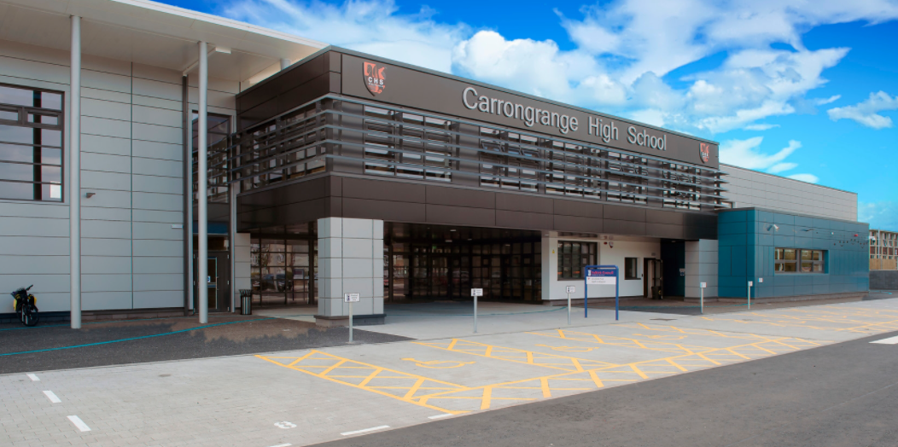



Carrongrange High School
Summer Edition Newsletter 2023

Slide 2
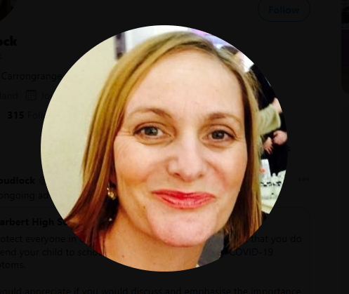

A message from our Headteacher
Mrs Proudlock
For those of you who attended our latest assembly, you’ll have been impressed with the work of our young people. The videos and pictures of camping trips showed a different side to our young people (and staff) and the smiles on their faces and fun they had showed just how much they were enjoying the experience. Many have talked of nothing else since! The presentation from Logan Mackay about SWAN UK (Syndrome Without a Name) for whom he is an ambassador, was an amazing display of confidence, resilience and skills for learning and life, staff were and are so proud of him for doing this. We also saw some excellent examples of work going on around the school, in Art, Trash Fashion and Green Hub’s work on Africa which started with an amazing parade which brought a tear to many an eye!
With school show this week, residentials next week and prom and award ceremonies the week after, this is shaping up to be a very busy term. We have also started transition work to new classes with new staff and peers and so far, our young people are coping amazingly well with this. It is lovely to see.

Slide 3
A message from our Headteacher
Mrs Proudlock
Ultimately, our young people display the school values of resilience, respect and responsibility on a daily basis. Working hard, encouraging and supporting each other and picking themselves up and getting on with it when things don’t always go their way, staff are proud of their achievements and their commitment to their school. I’ve said how busy this term is but as a term, it brings out the best in our young people and award ceremonies aside, they are all wonderful young people who should be very proud of what they have achieved in their school year, I certainly am.
Janine Proudlock : Headteacher : Carrongrange High School : Janine.proudlock@falkirk.gov.uk : 01324 492592

Slide 4



GRANGE HOUSE
Pupils of the month
April 2023
BGE: Alex Evans – Alex has come such a long way with his communication both in class and across the school. We are all so proud of him.
Seniors: Ryan Dick – For working diligently at the Coffee Cart. Ryan has also completed all his assessments and shown a good attitude in class.

Slide 5

Pupils of the month
INCHYRA HOUSE
April 2023
BGE: Jamie McLuckie – Jamie has dealt with everything in his stride over the last few weeks and we are very proud of him.
Seniors: Stephen Black – Being more independent at lunchtime and listening to instructions and brightening up everyone’s day.

Slide 6

RANNOCH HOUSE
Pupils of the month
April 2023
BGE: Ellie Clarkson – Ellie is showing real maturity over the last couple of months, listening well to instructions. She is helpful to others, responsible and kind.
Seniors: Enrik Carvatchi – Helping with the breakfast rolls and cleaning the laser cutter.

Slide 7

ZETLAND HOUSE
Pupils of the month
April 2023
BGE: Jack Henderson – he has worked well and patiently recovered from his operation.
Seniors: Peter Wright – for doing well in swimming.

Slide 8
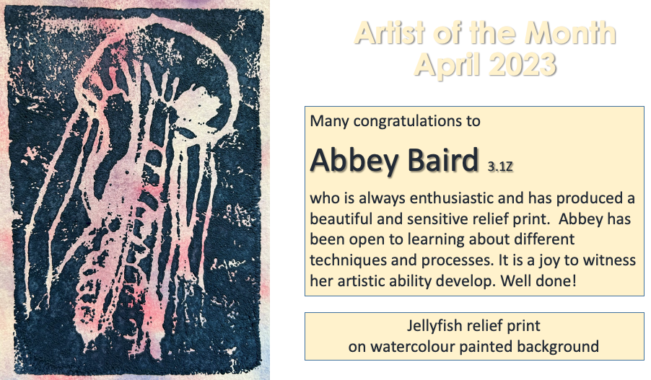

Slide 9
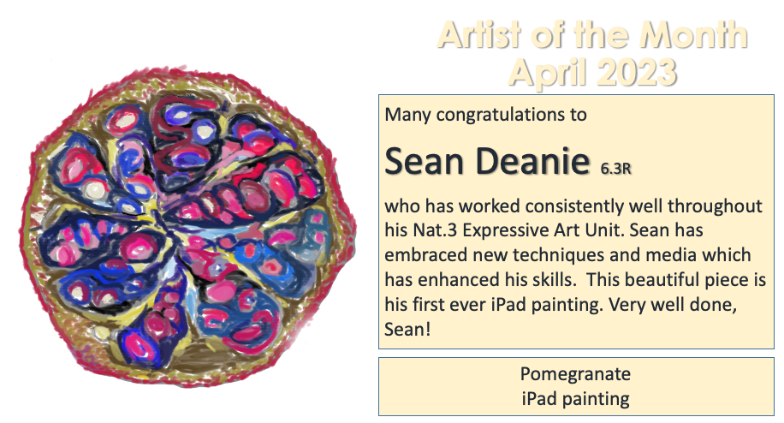

Slide 10

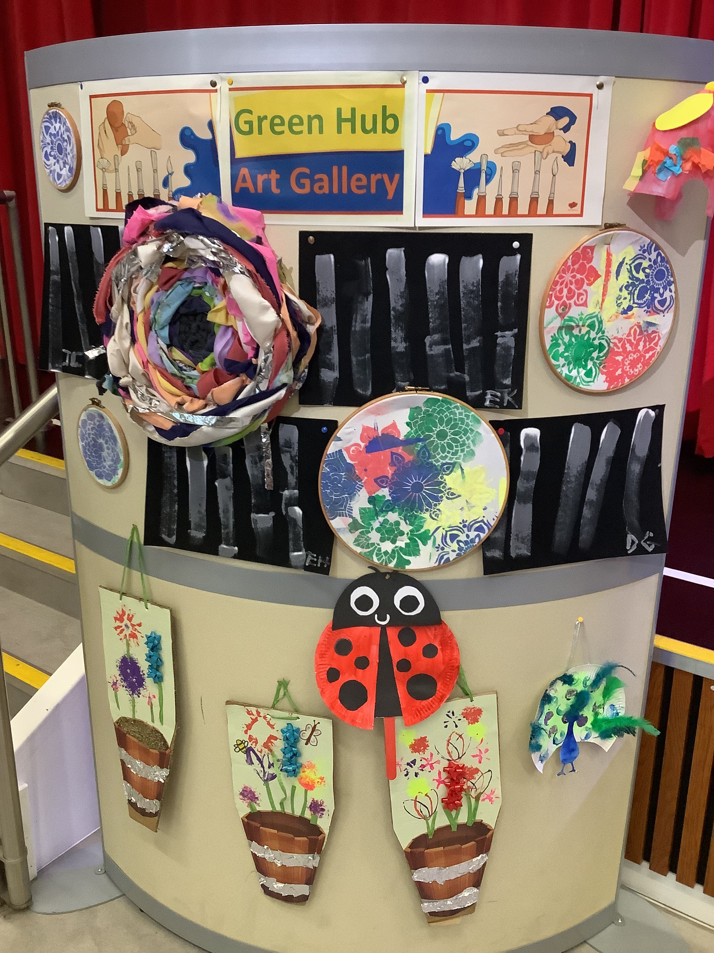
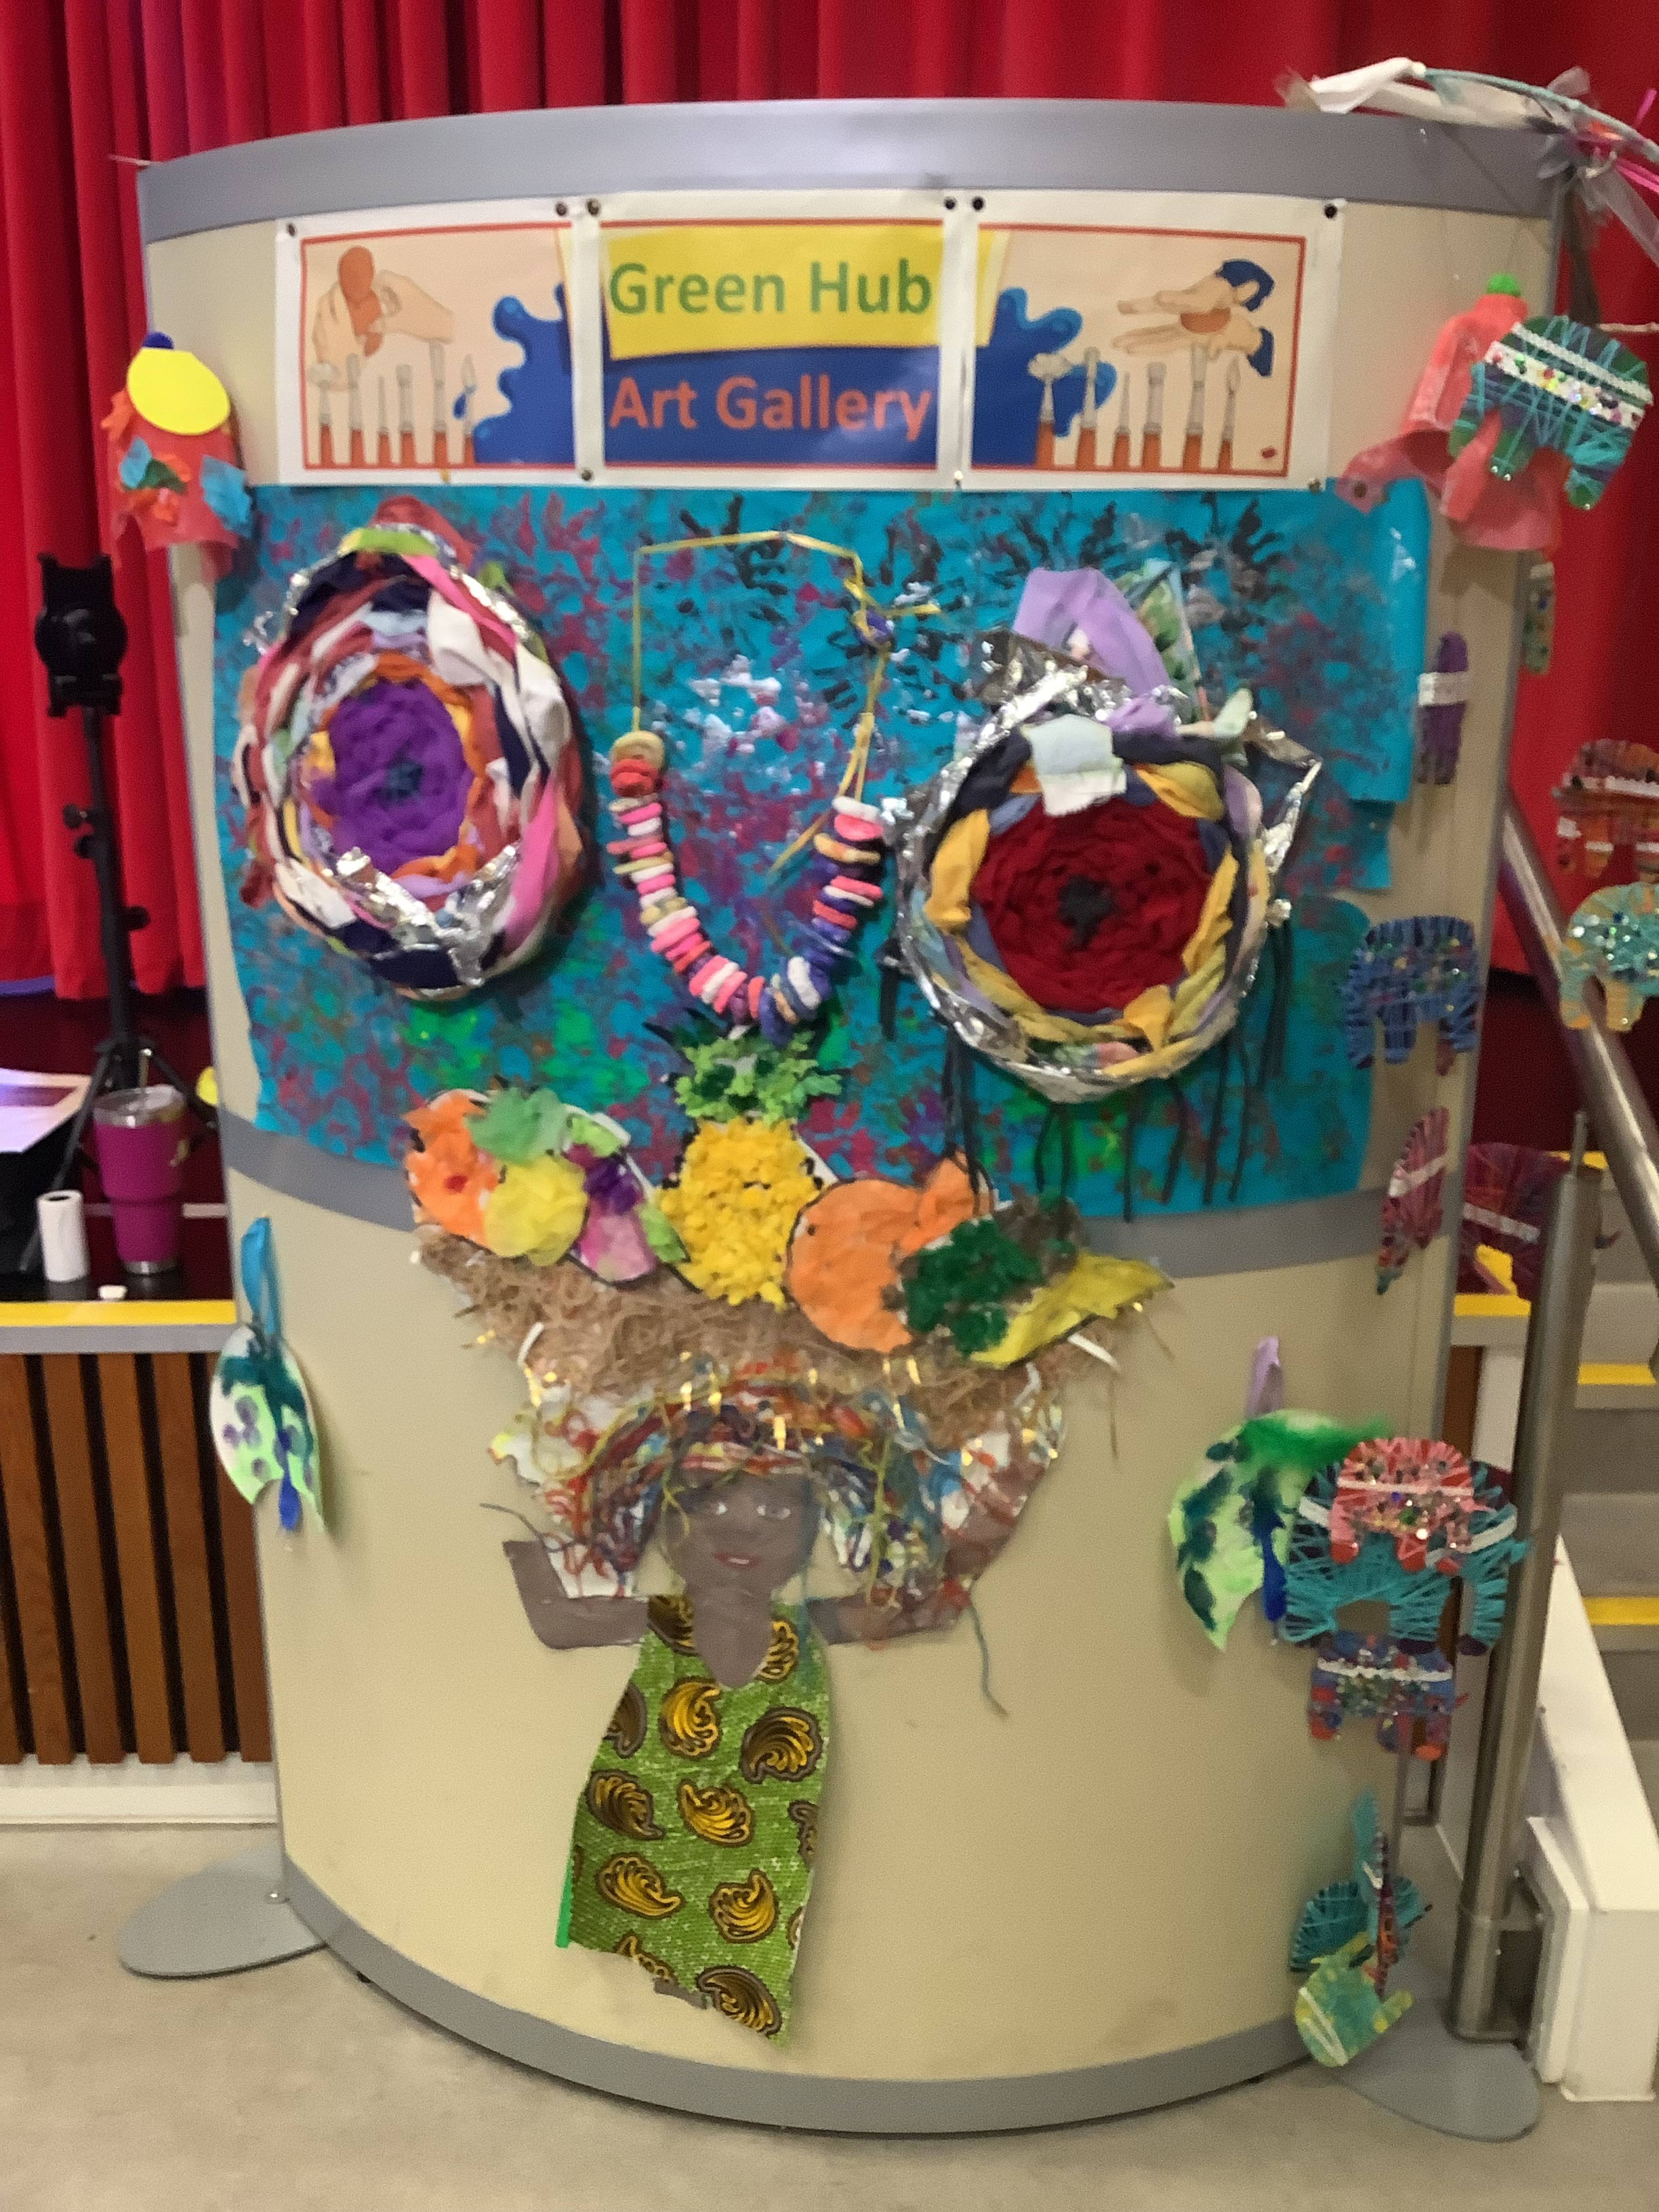
Green Hub Art Attack
The Green Hub were very busy creating a fantastic display for our assembly hall.

Slide 11
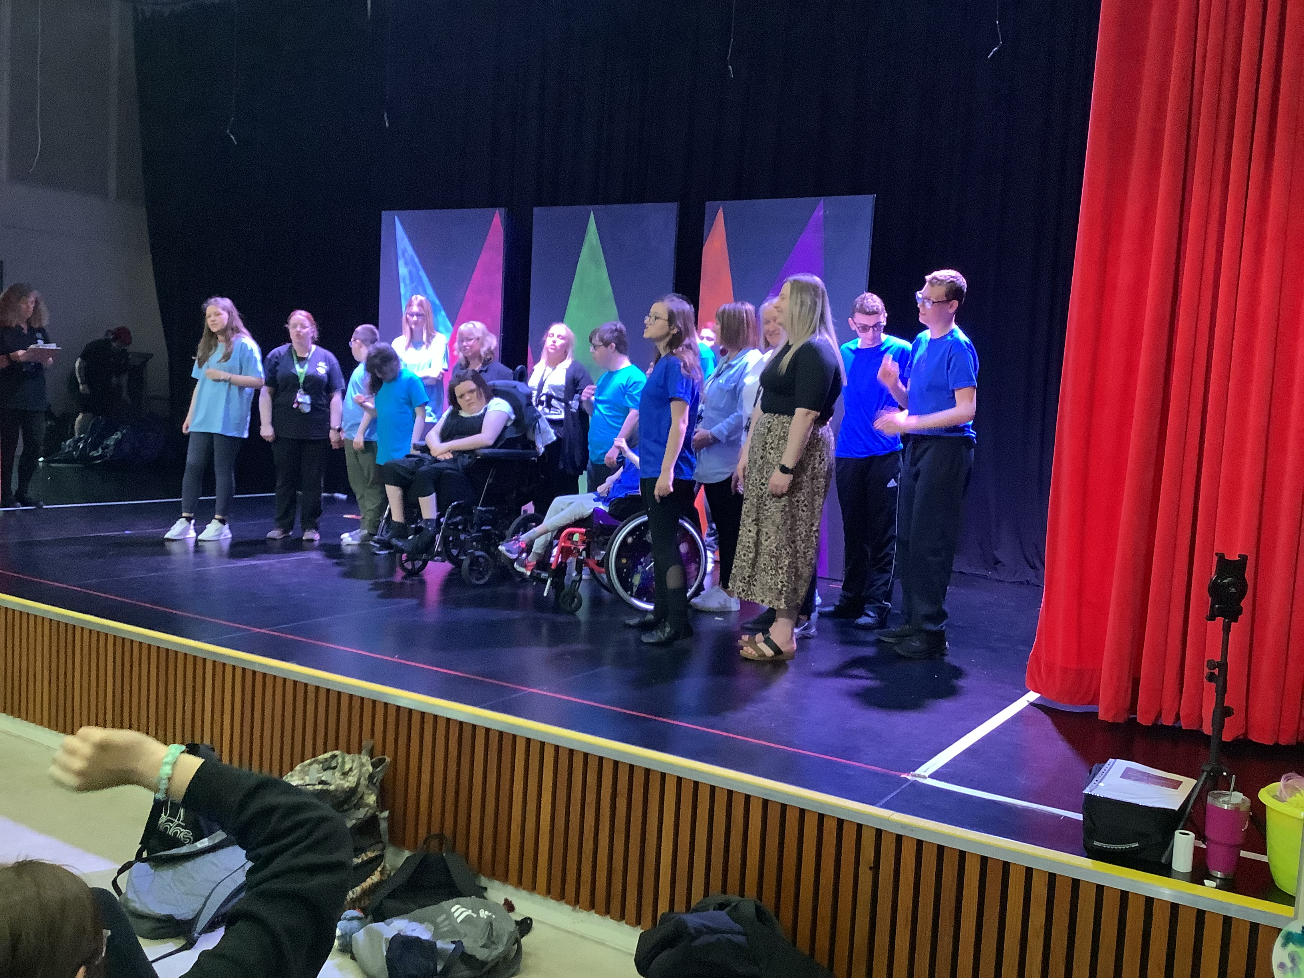
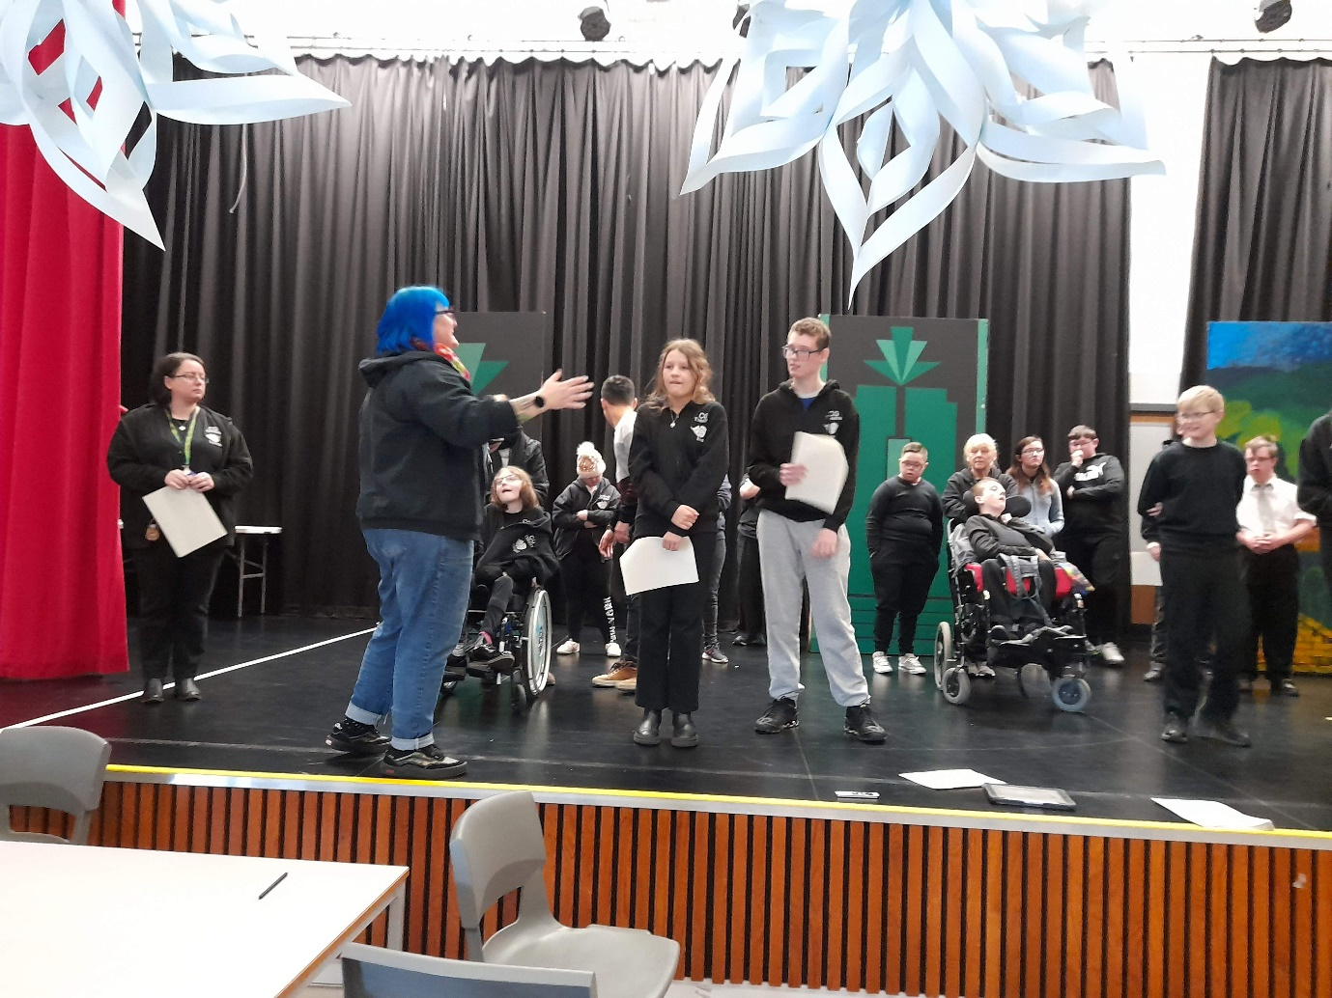
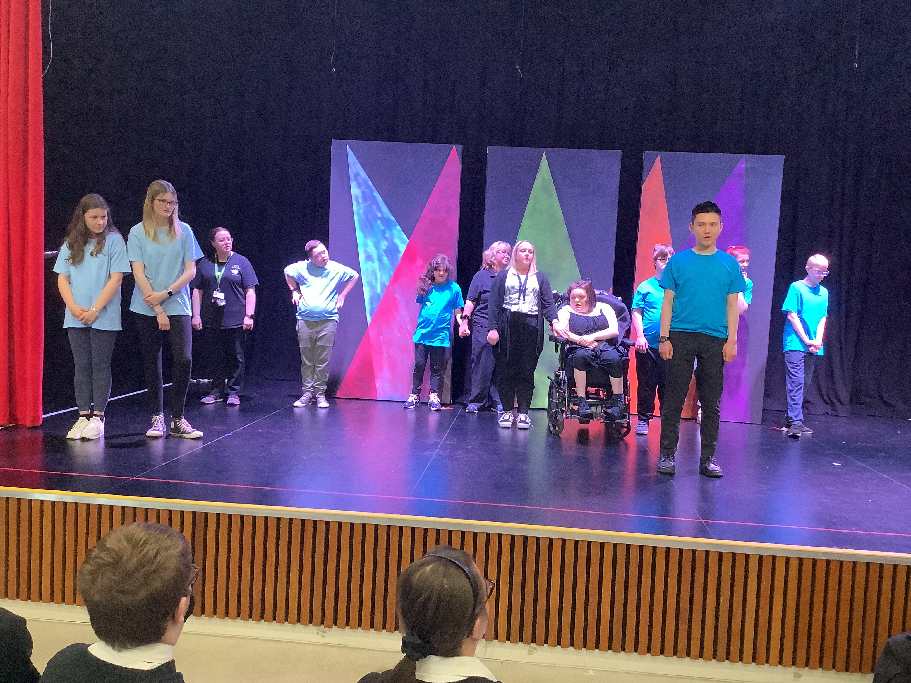
Carrongrange Theatre School Show.
We are so proud of our talented and committed young people, and of the staff supporting them, in making the show a sell out and a fantastic evening of entertainment!

Slide 12
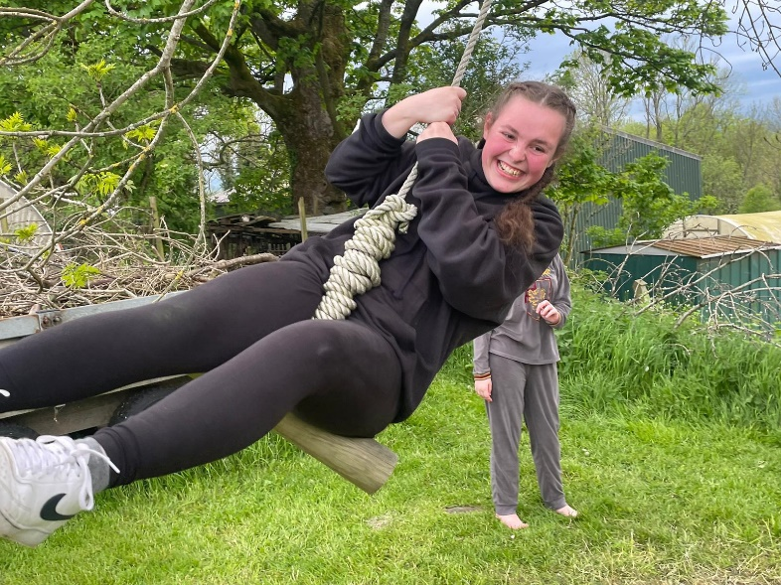
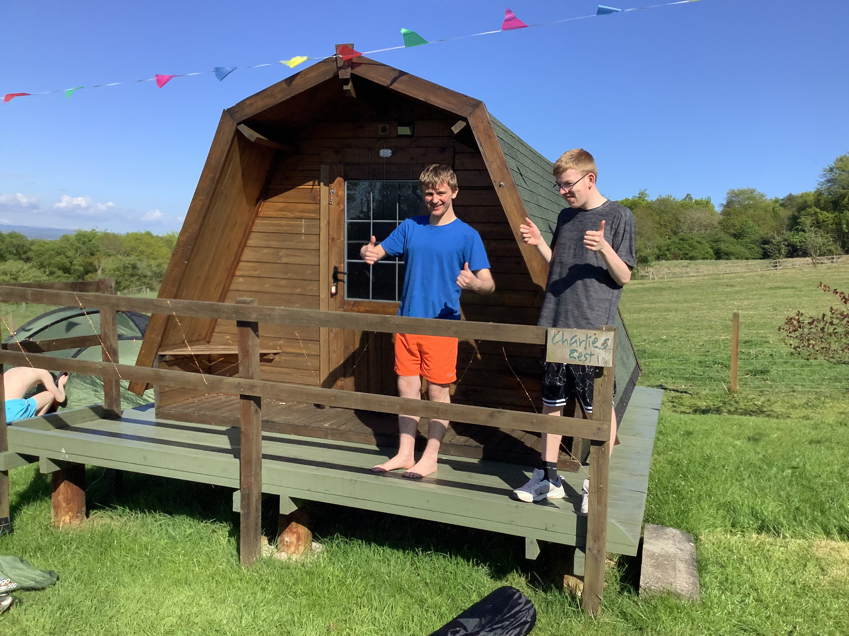
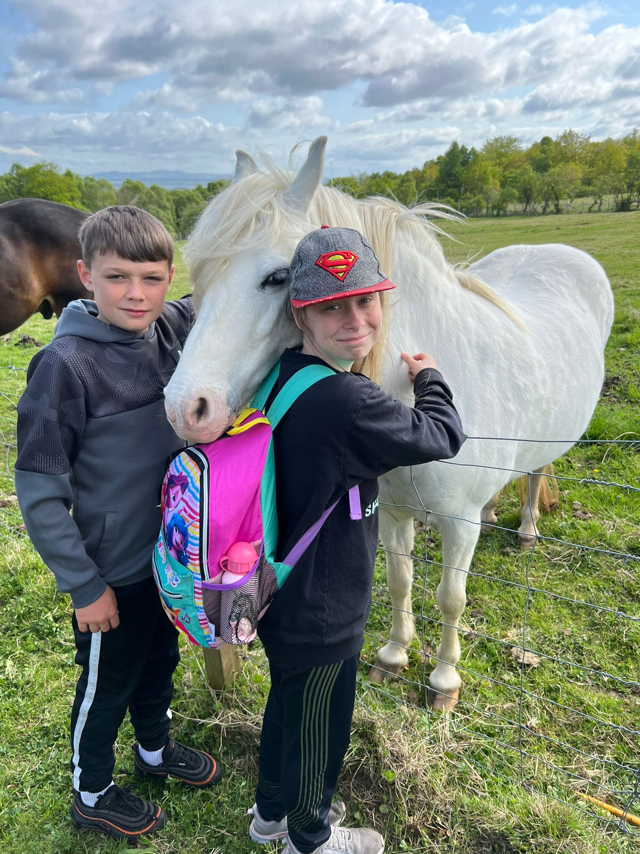
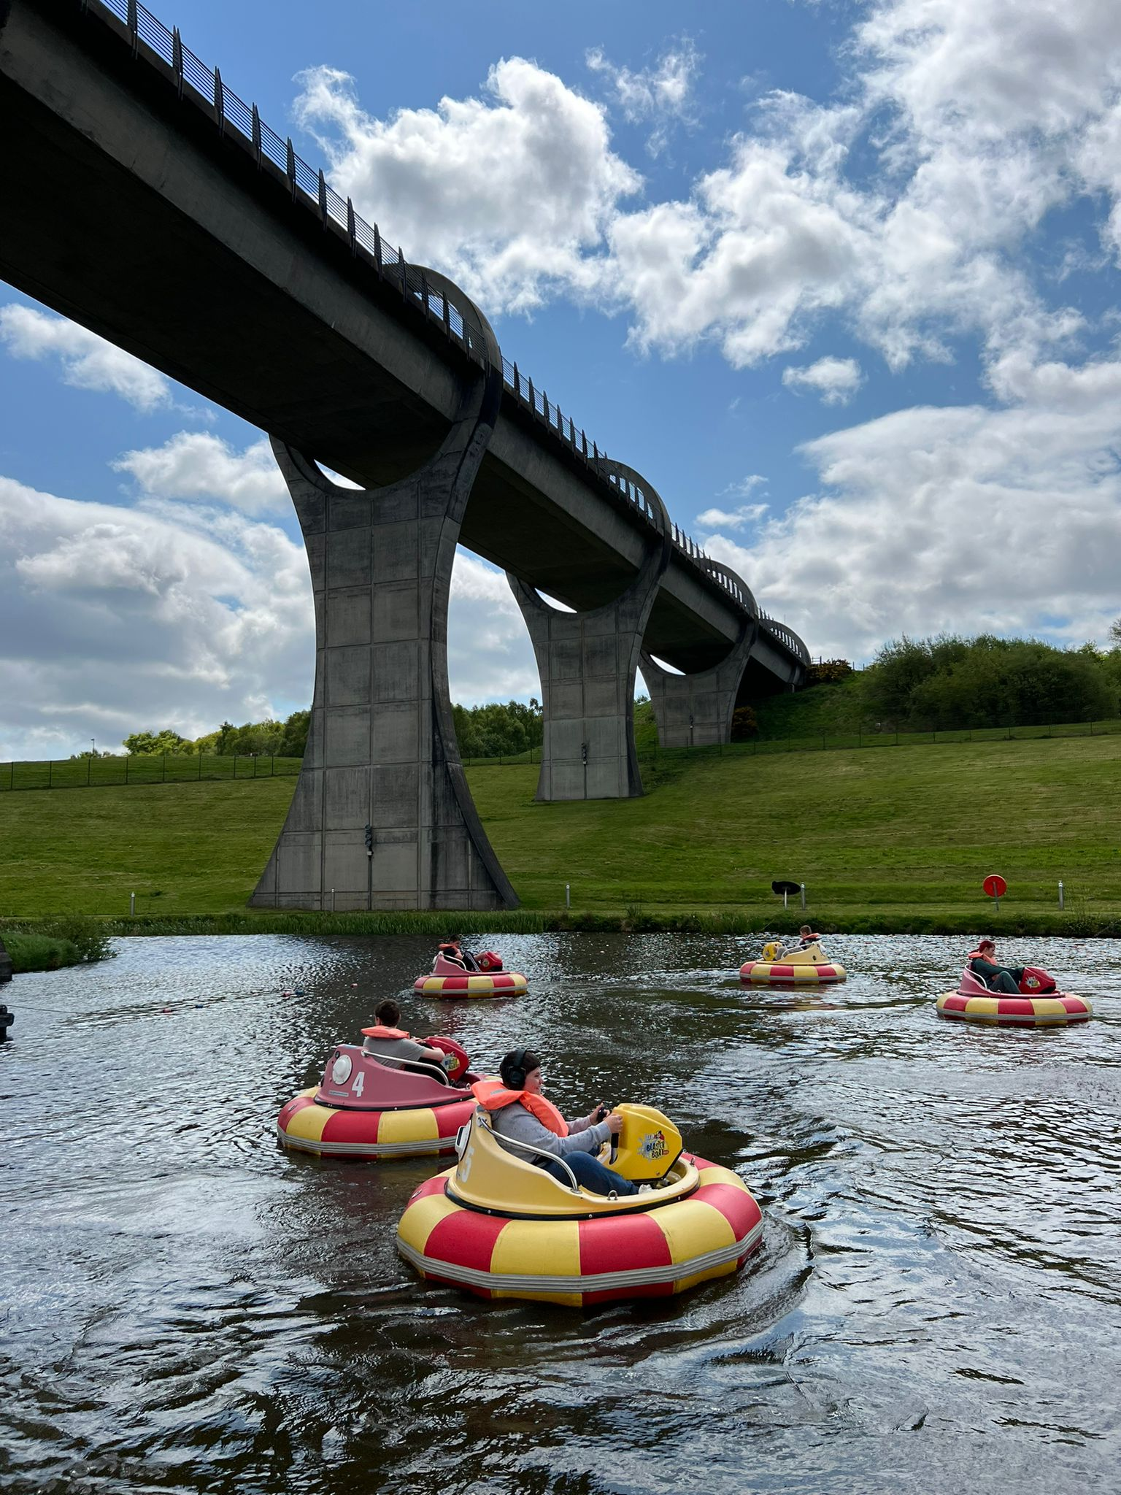
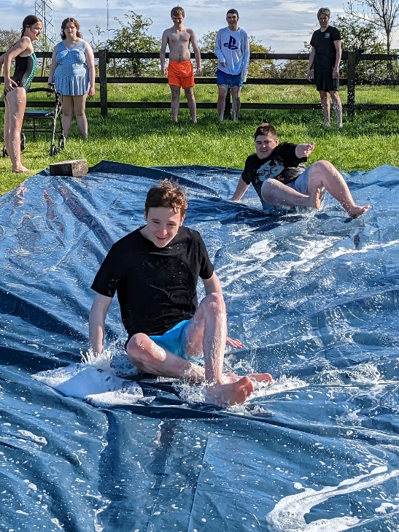
Summer Camping Fun @ Spoke n Boot Farm

Slide 13
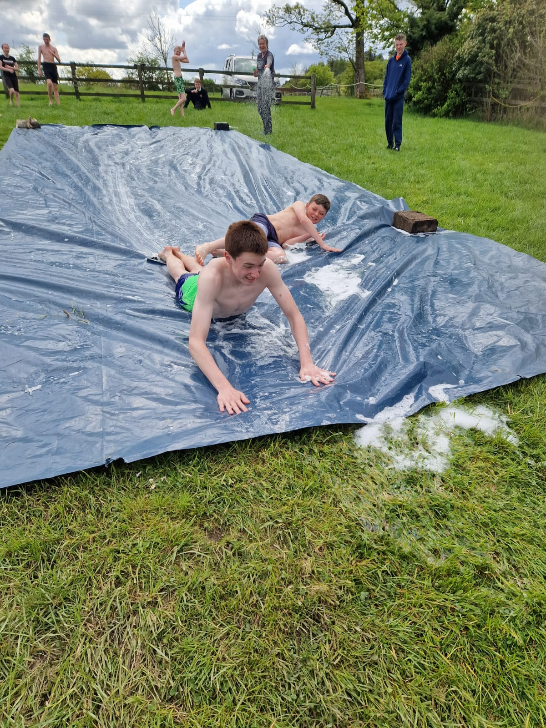
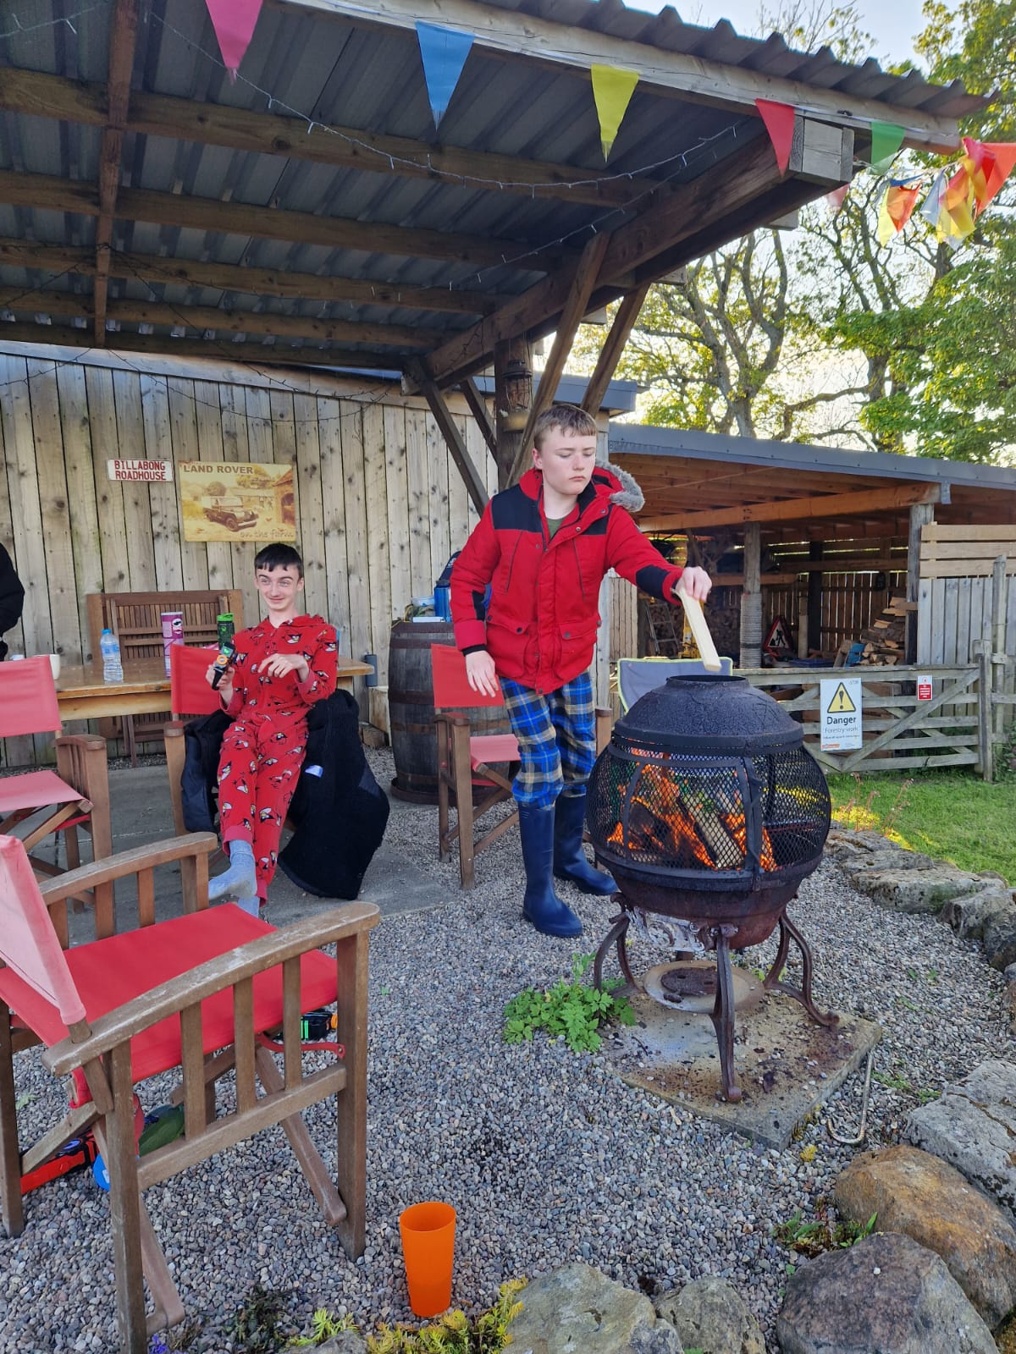
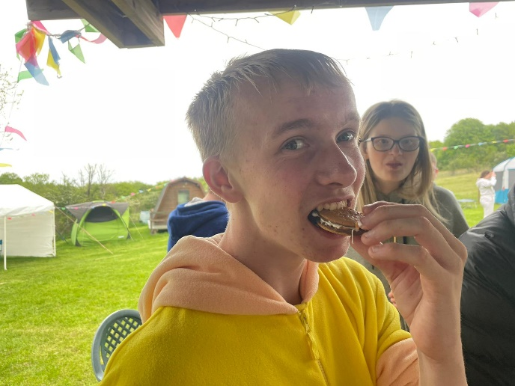
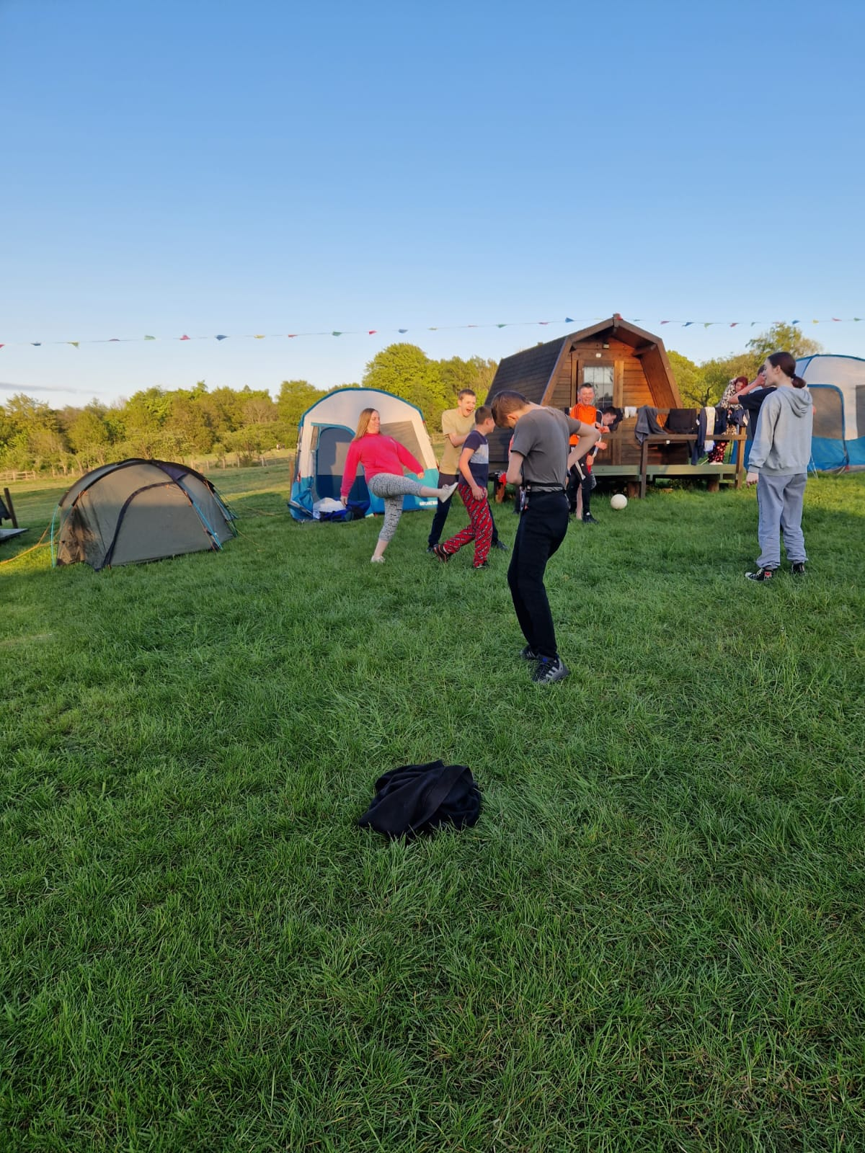
Pupils in BGE and Seniors had a fantastic time camping @ Spoke n Boot Farm.
Slip n slide fun, smores & burgers on the BBQ, fresh air, campfires & and fun with friends!

Slide 14

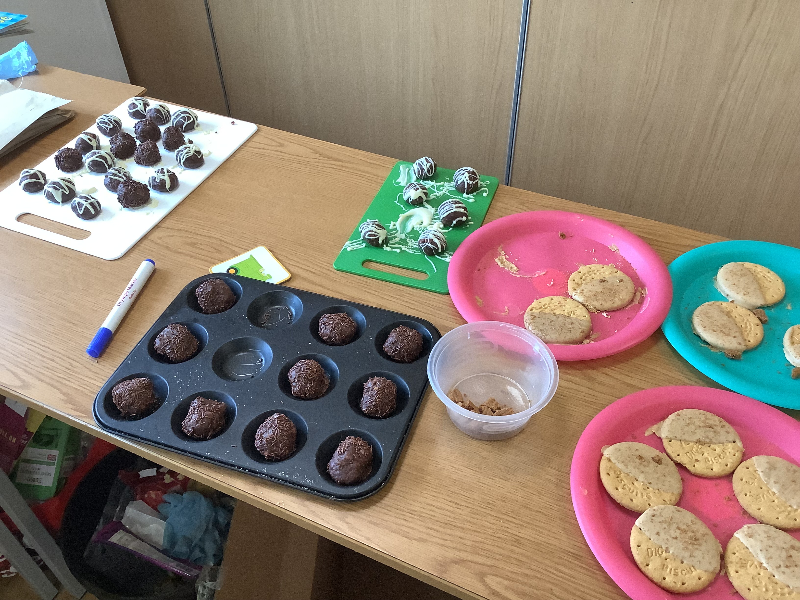
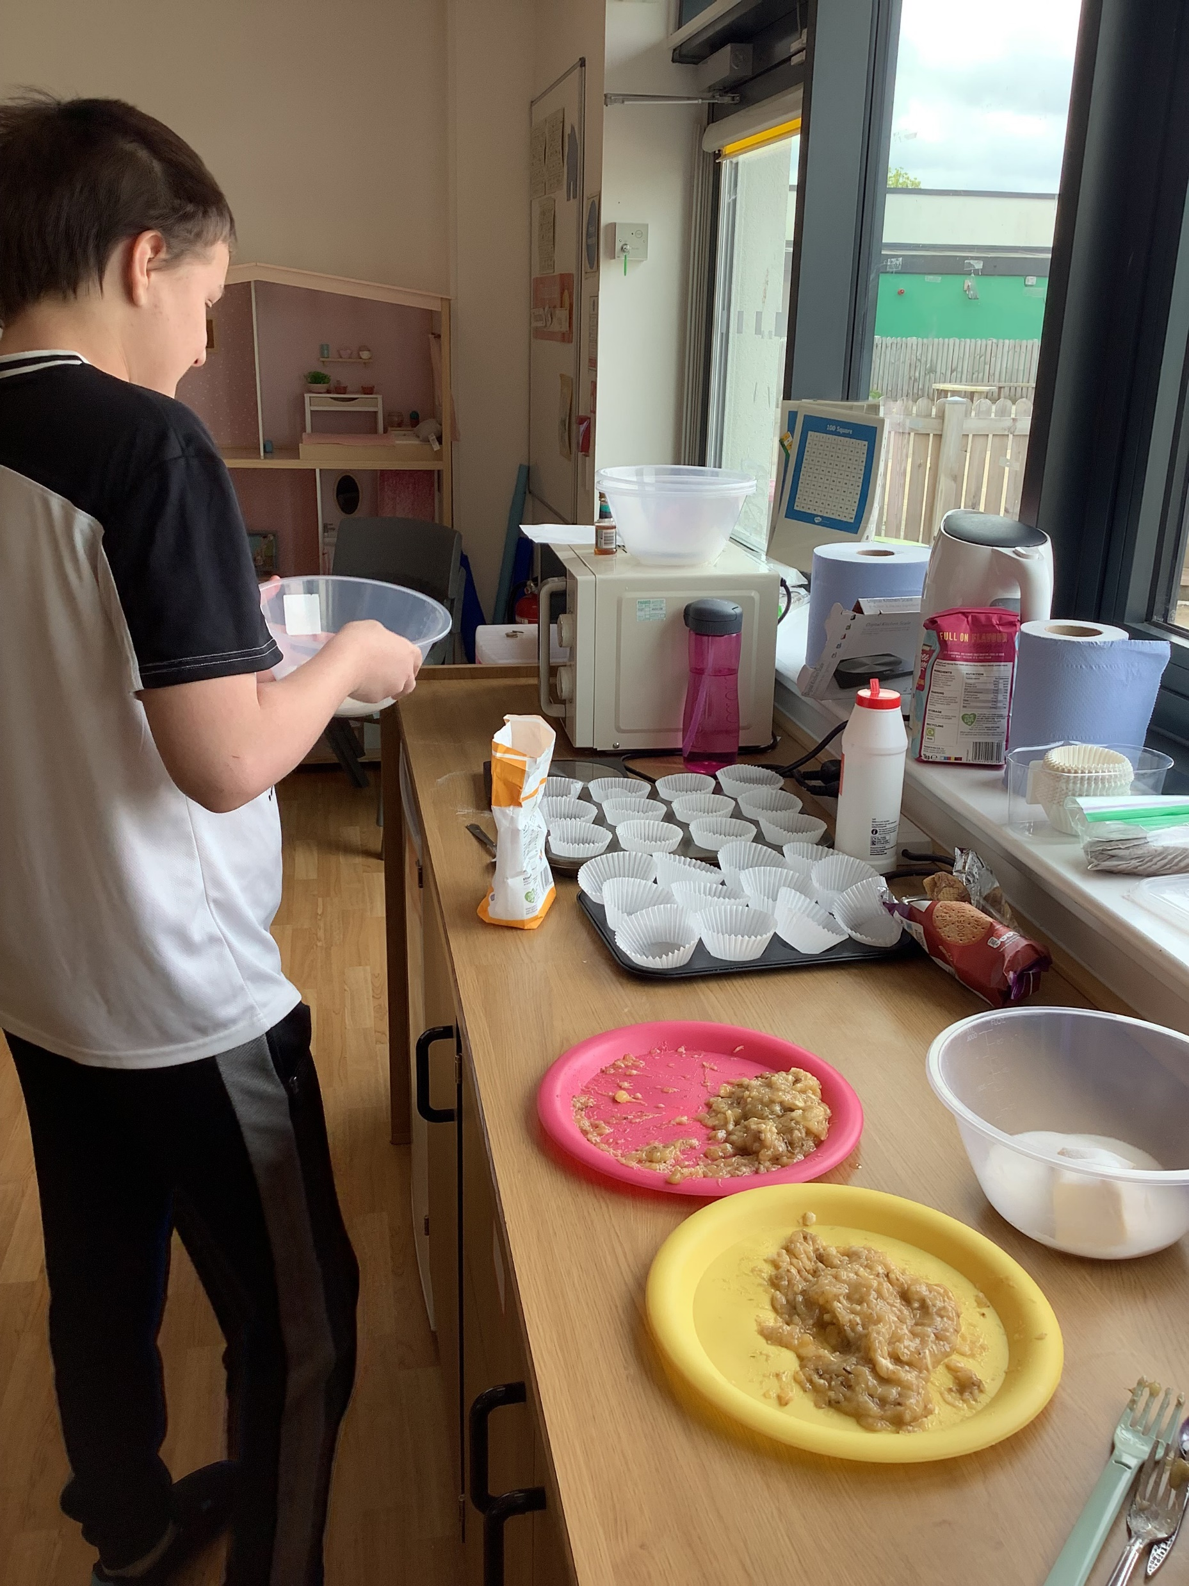
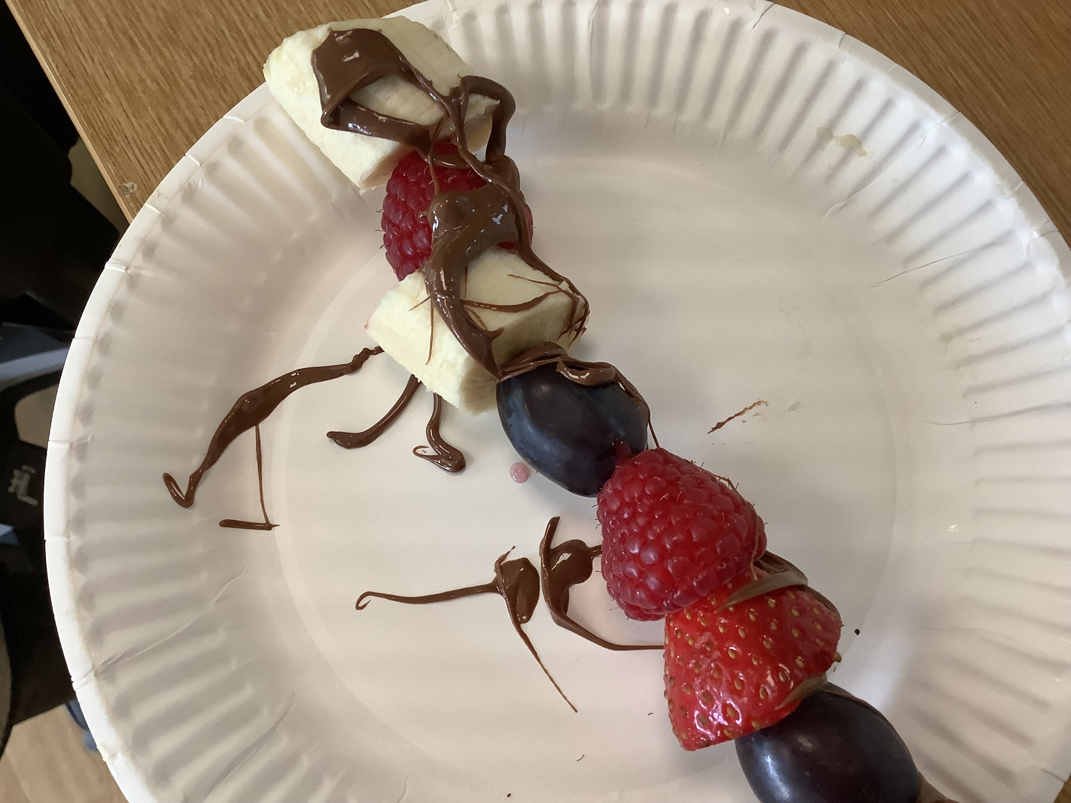
Enterprise at Carrongrange
“Classes 4.1 and 4.3 decided to challenge ourselves to create Enterprise Projects during the months of April and May. We divided pupils into two groups to create, design, advertise and sell products within the school. Each group developed a name for our projects, Oh My Goodies and Fruitastic both selling yummy edibles.
We then evaluated our Enterprise projects by working out our profit from each business. We had lots of fun doing this!”

Slide 15

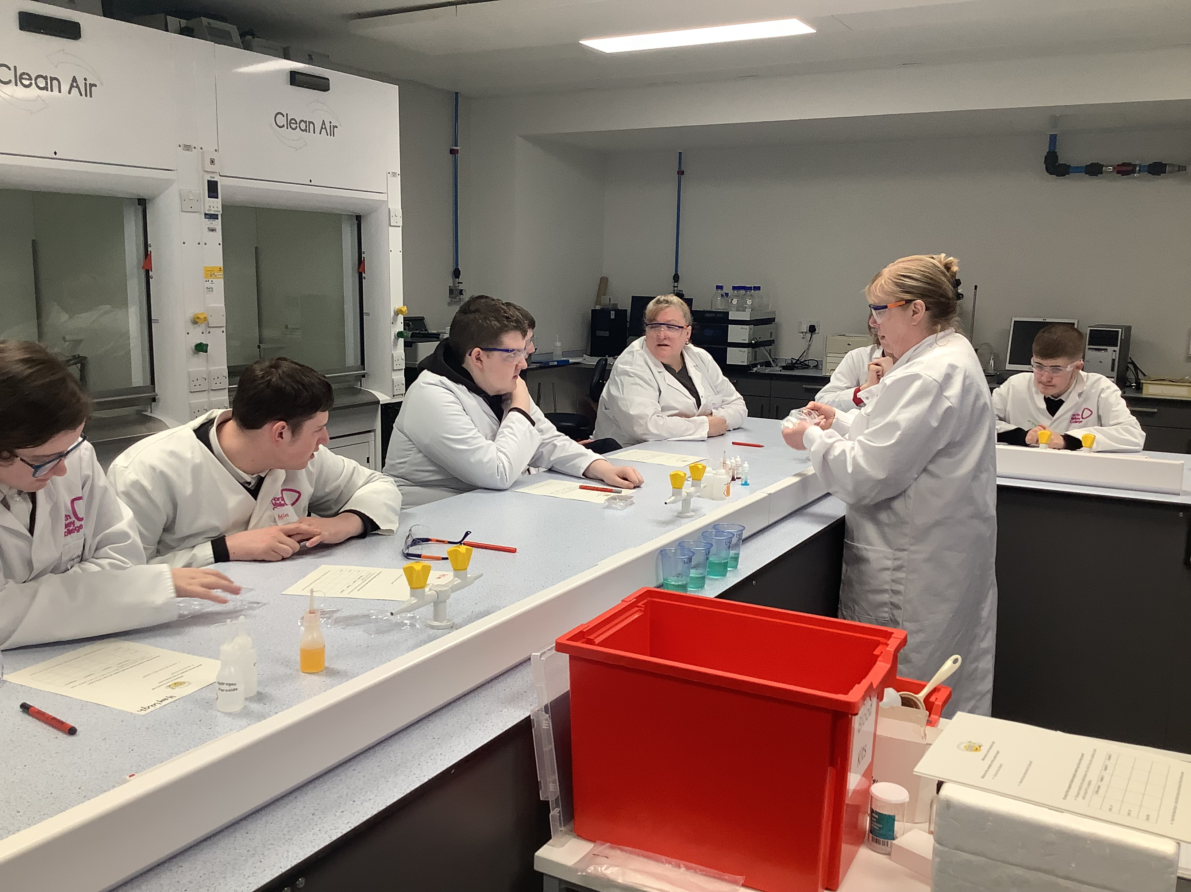
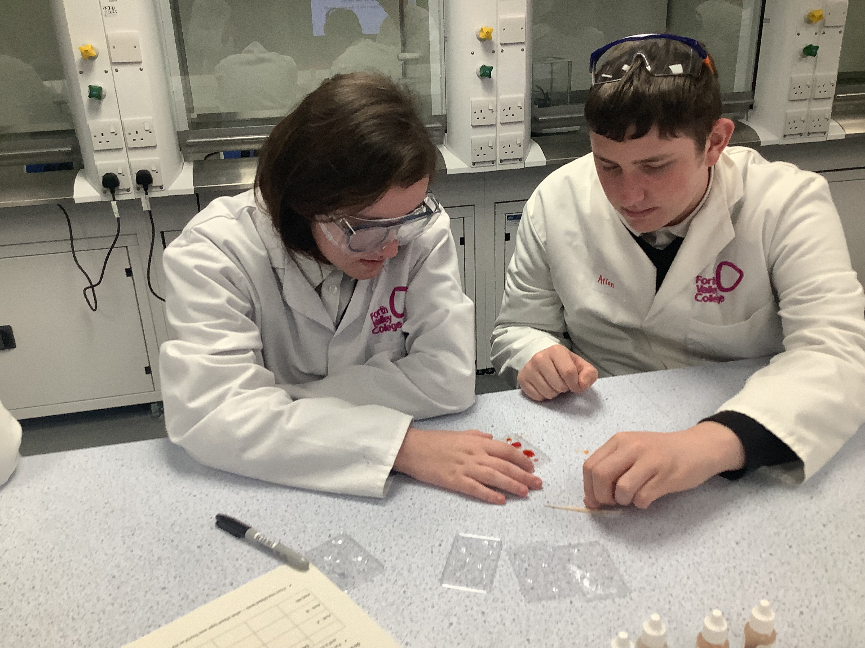
The Learning Lab
A group of S5 pupils visited the Falkirk campus of Forth Valley College in April to take part in a project designed to let them experience real world applications of science.

Slide 16

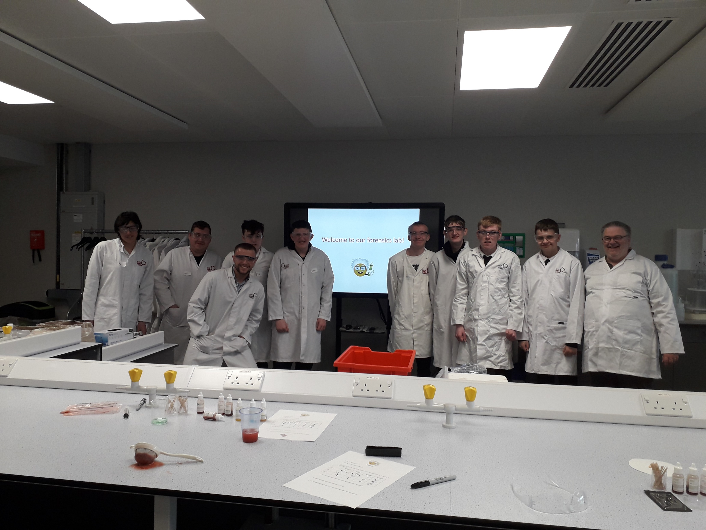
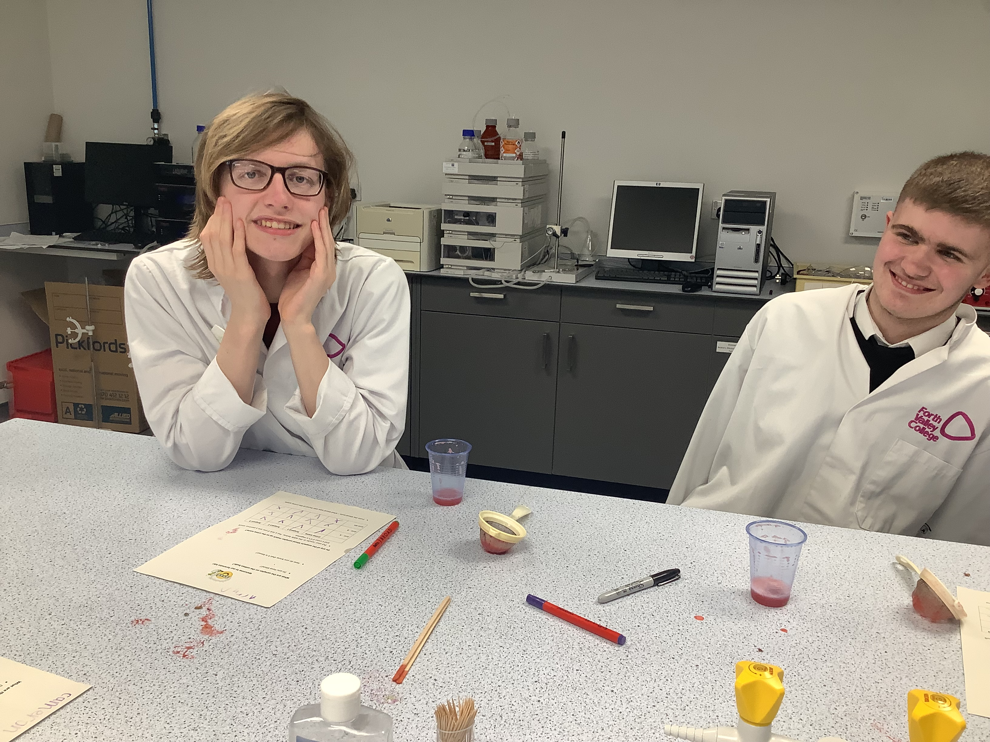
The Learning lab
The group were set the task of solving a crime. They were given blood samples and were able to use scientific techniques to work out blood types and to extract DNA.
A very enjoyable and informative morning.

Slide 17

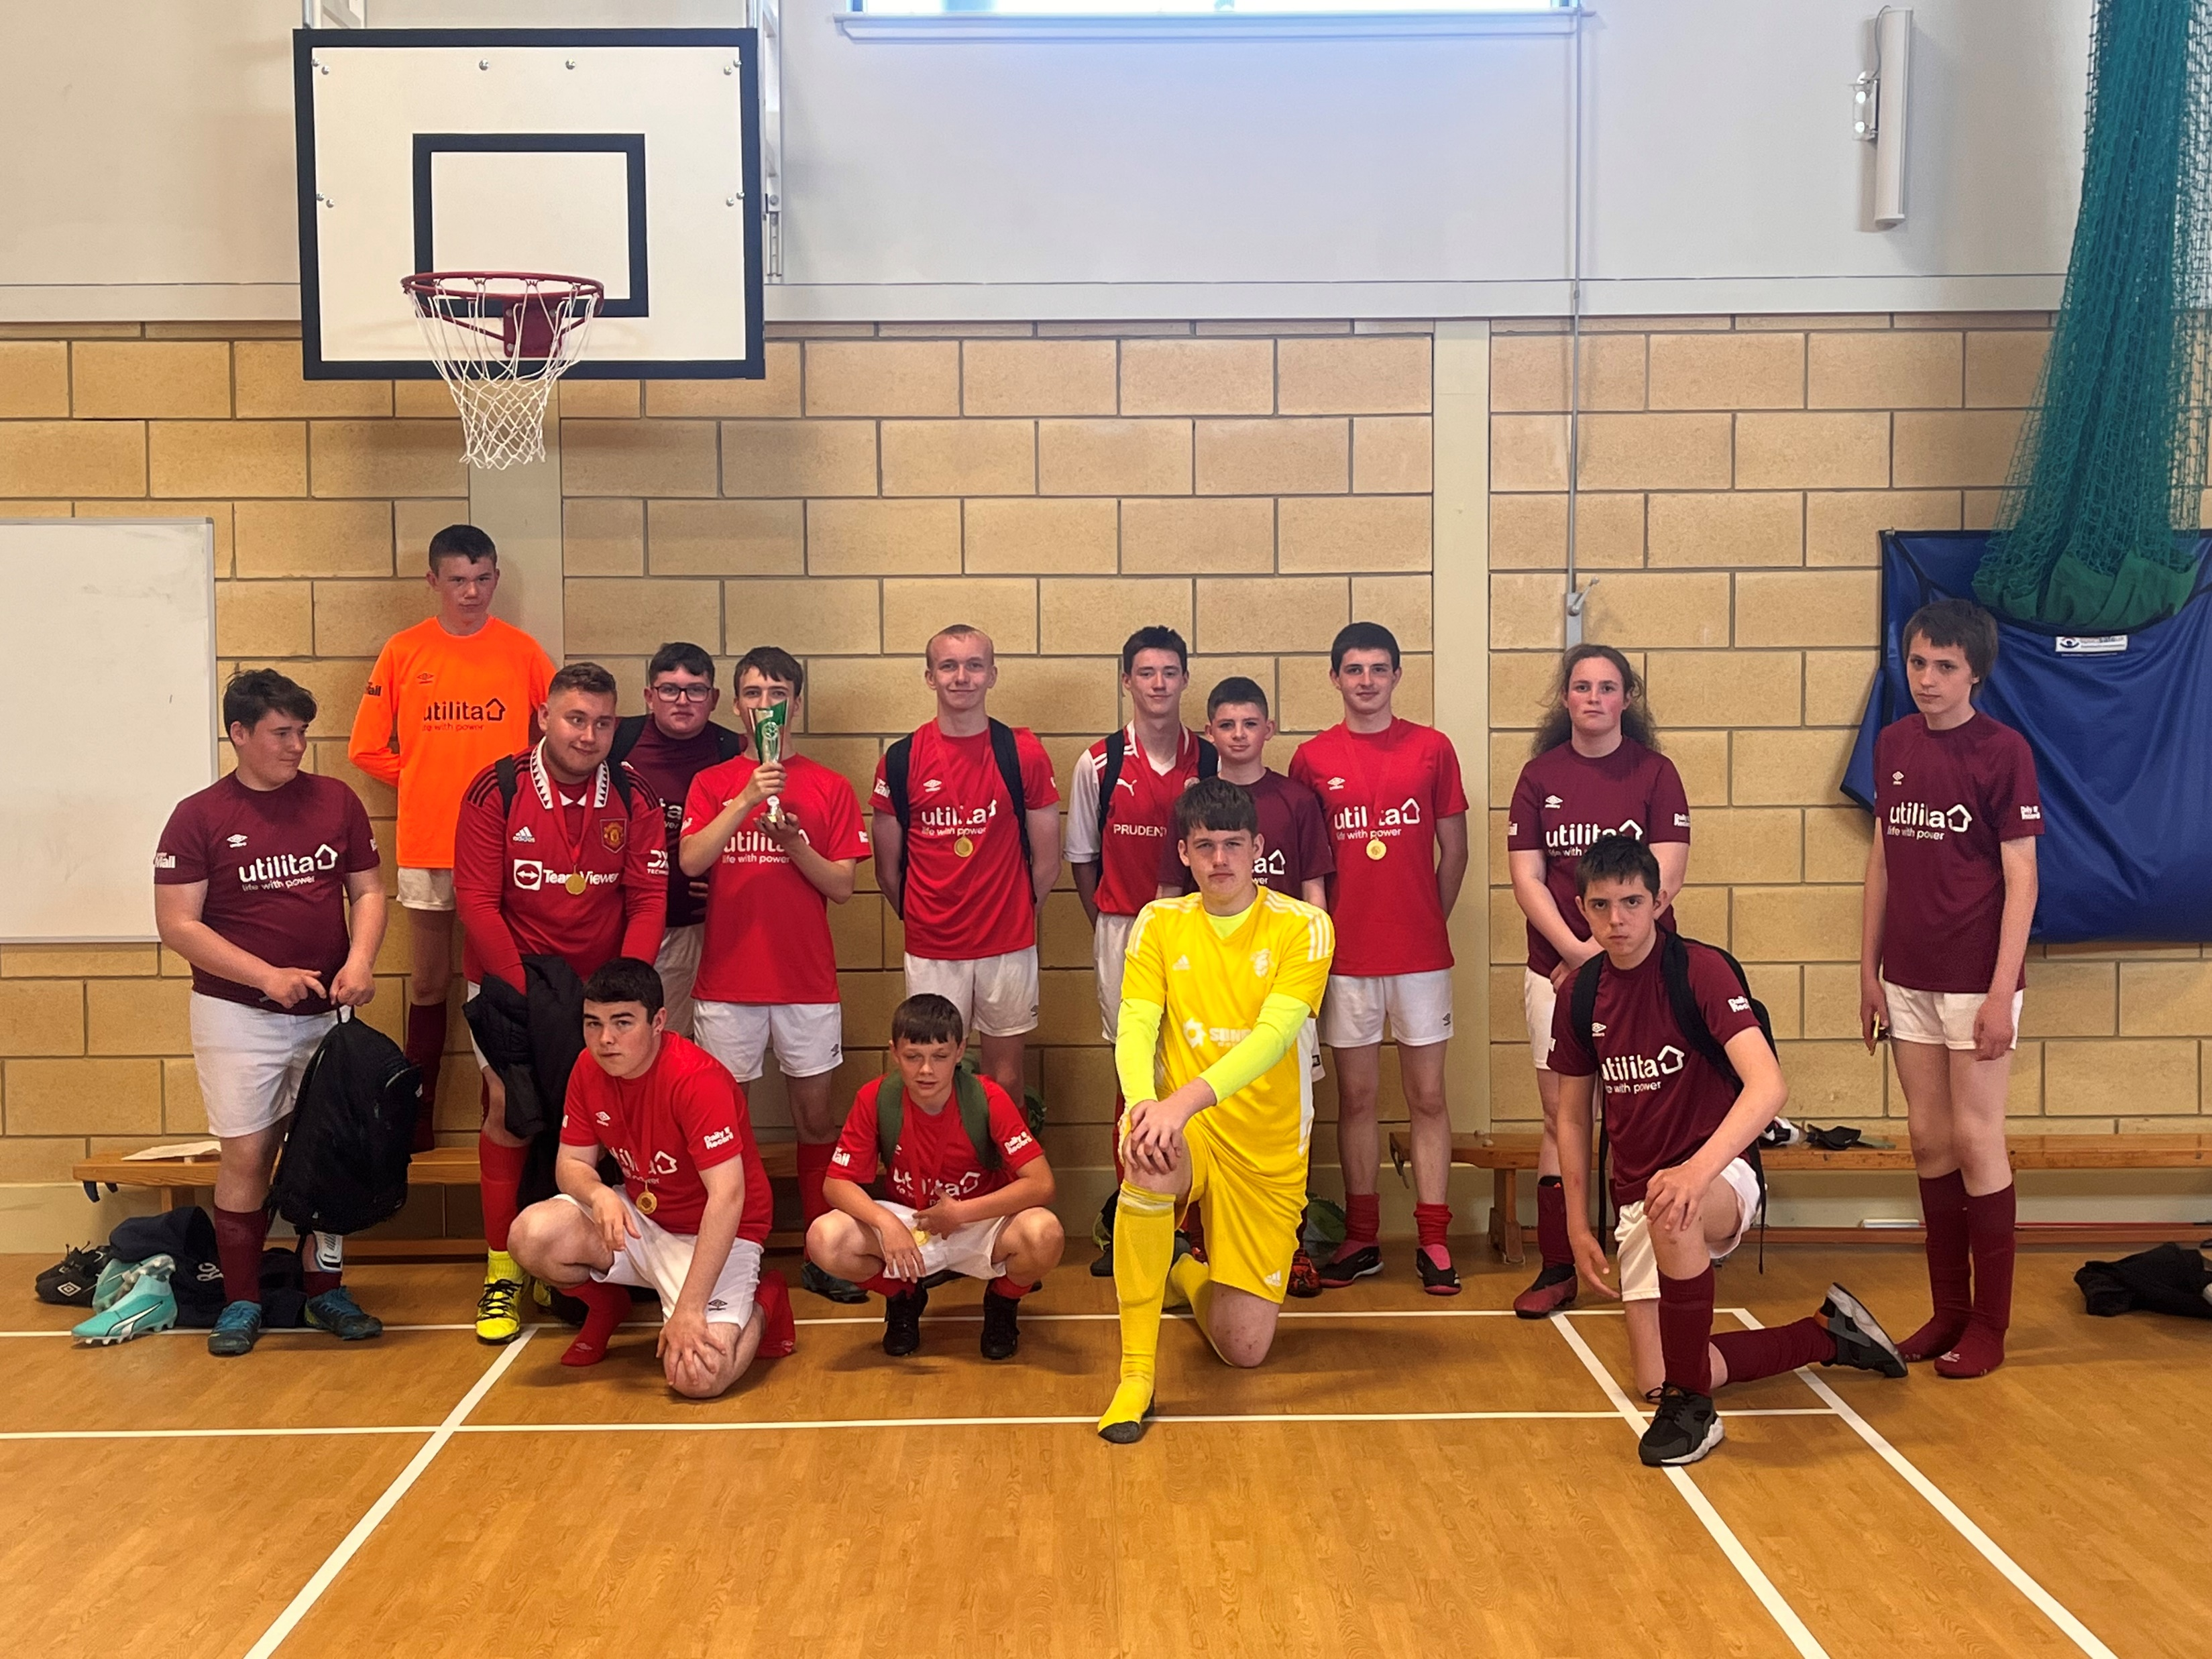
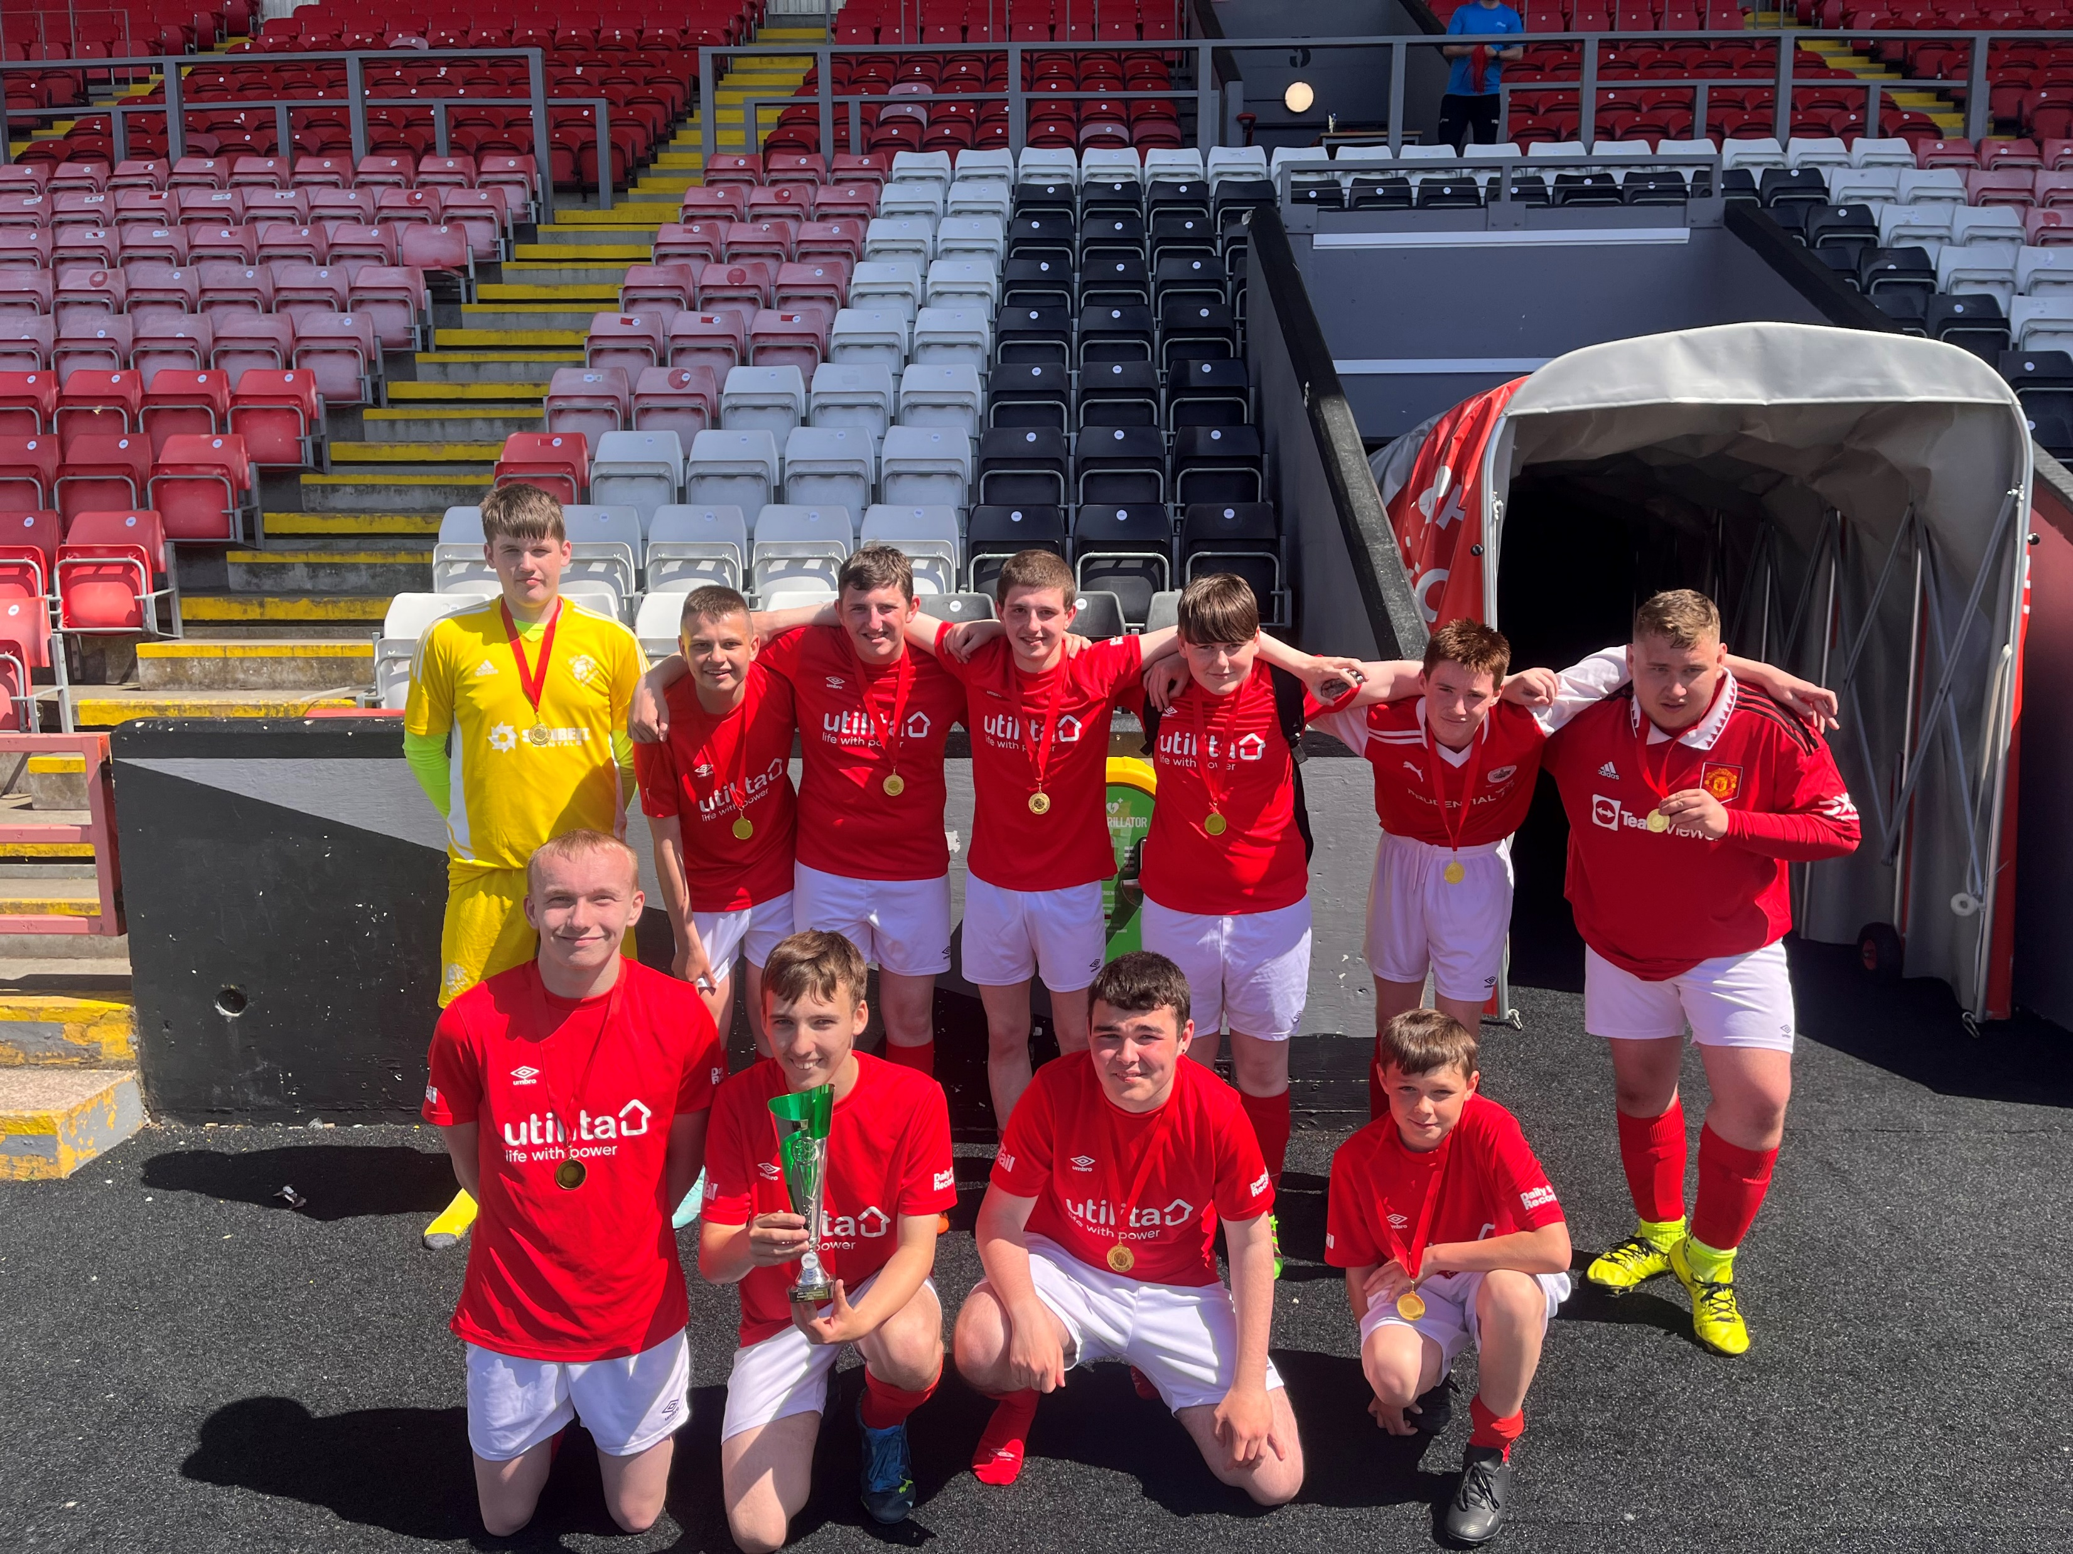
Carrongrange Football Team
A huge well done to Carrongrange football team this week on becoming the ASN League Cup winners.
The pupils have been playing in an extremely high level competition since the start of the year, competing against some fantastic players and very capable teams.

Slide 18
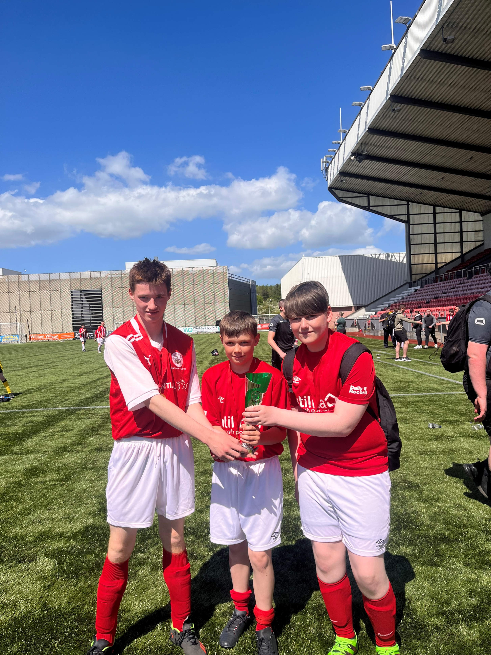
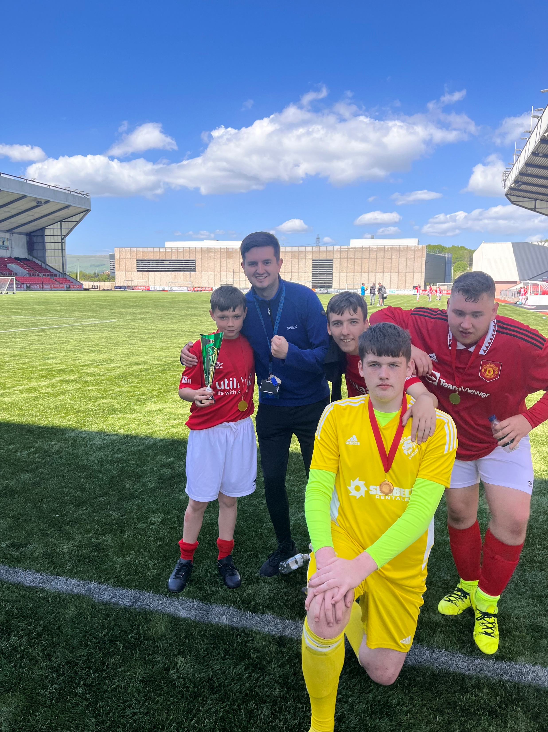
Carrongrange Football Team
All their hard work, commitment and enthusiasm paid off yesterday when they were crowned champions in a very close and dramatic finish.
Well done to coach Cruickshanks (the winning run continues) and coach Spiers….watch out, the Premiership clubs surely must be looking at this dynamic duo!!

Slide 19

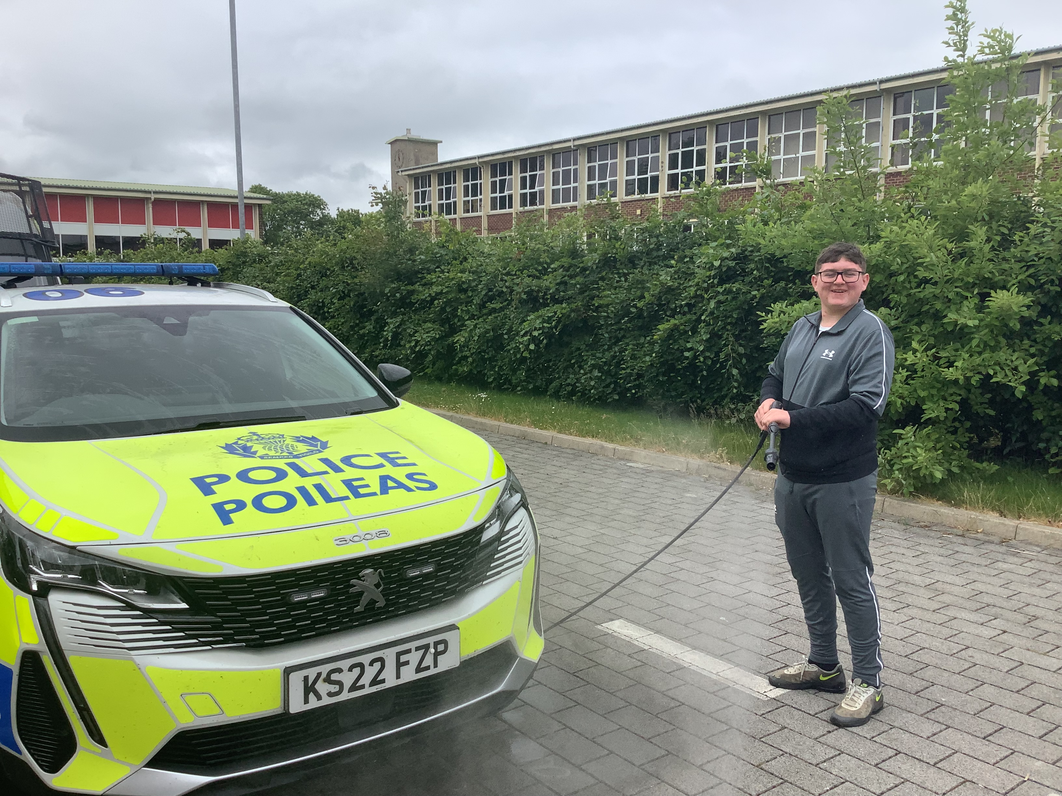
Police Scotland Visit to Carrongrange
Police Scotland were “called out” to Carrongrange today.
Our pupils (and staff) had a great time looking around and getting pictures in the riot van and police cars.
Our resident Car Washers also had a great time cleaning the police vehicles.

Slide 20
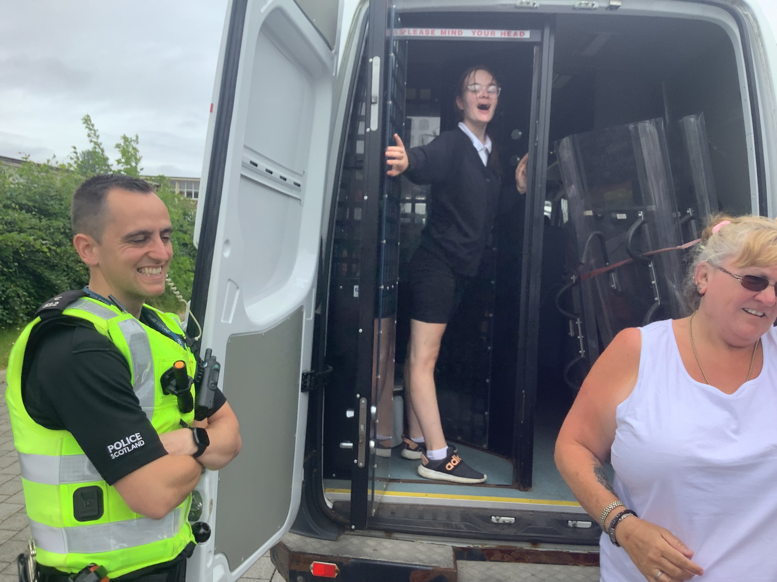
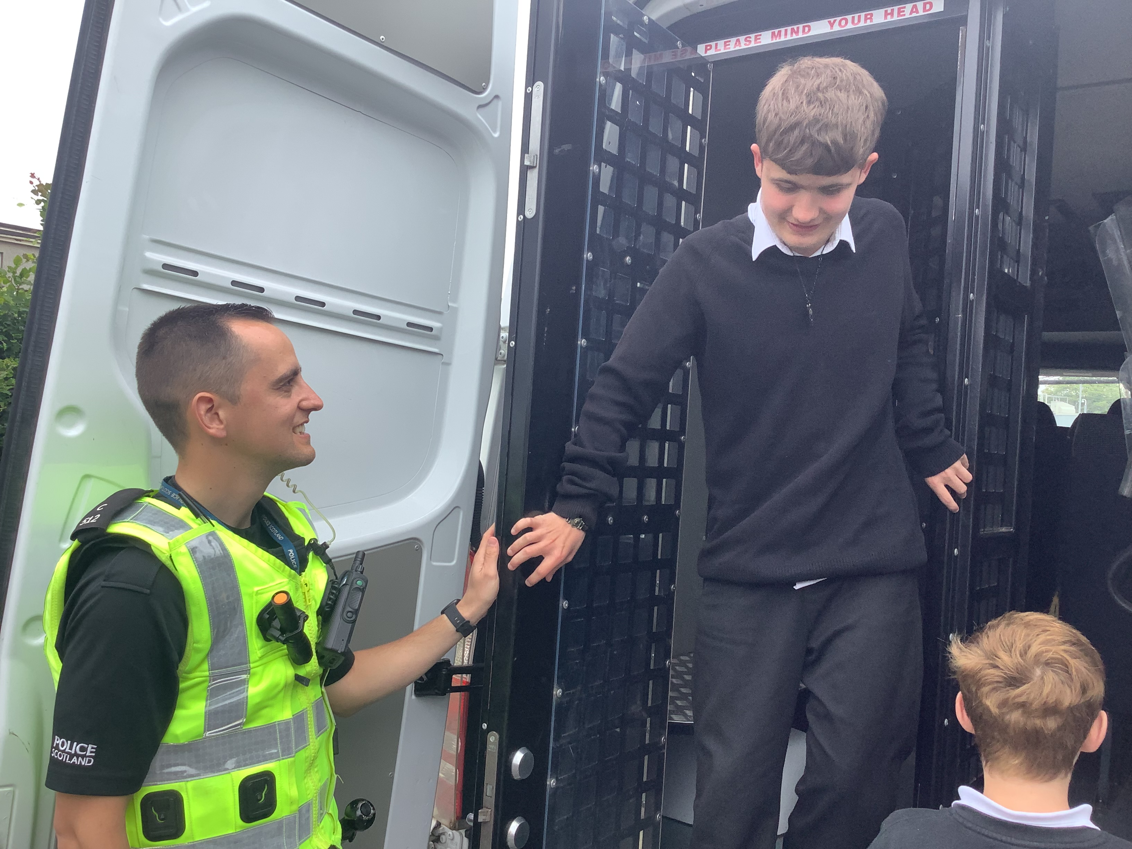
Police Scotland Visit to Carrongrange

Slide 21

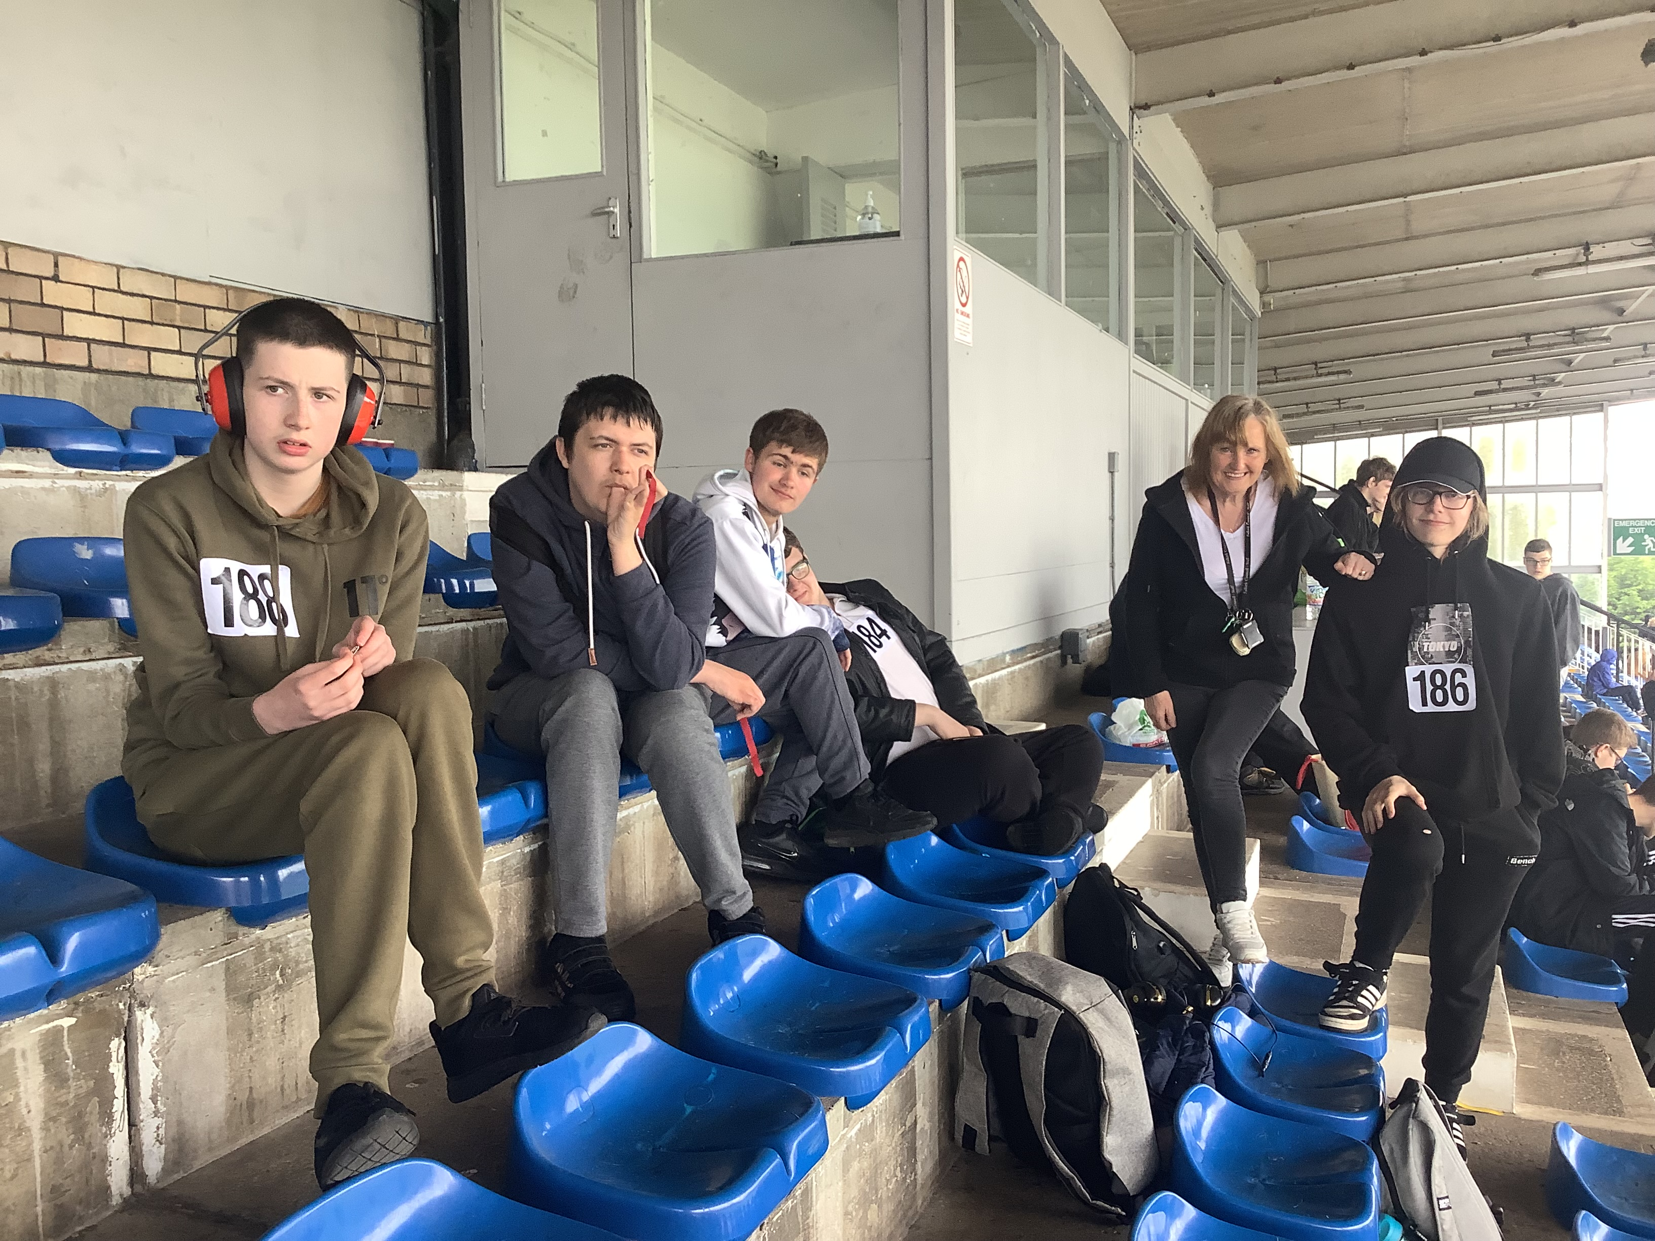
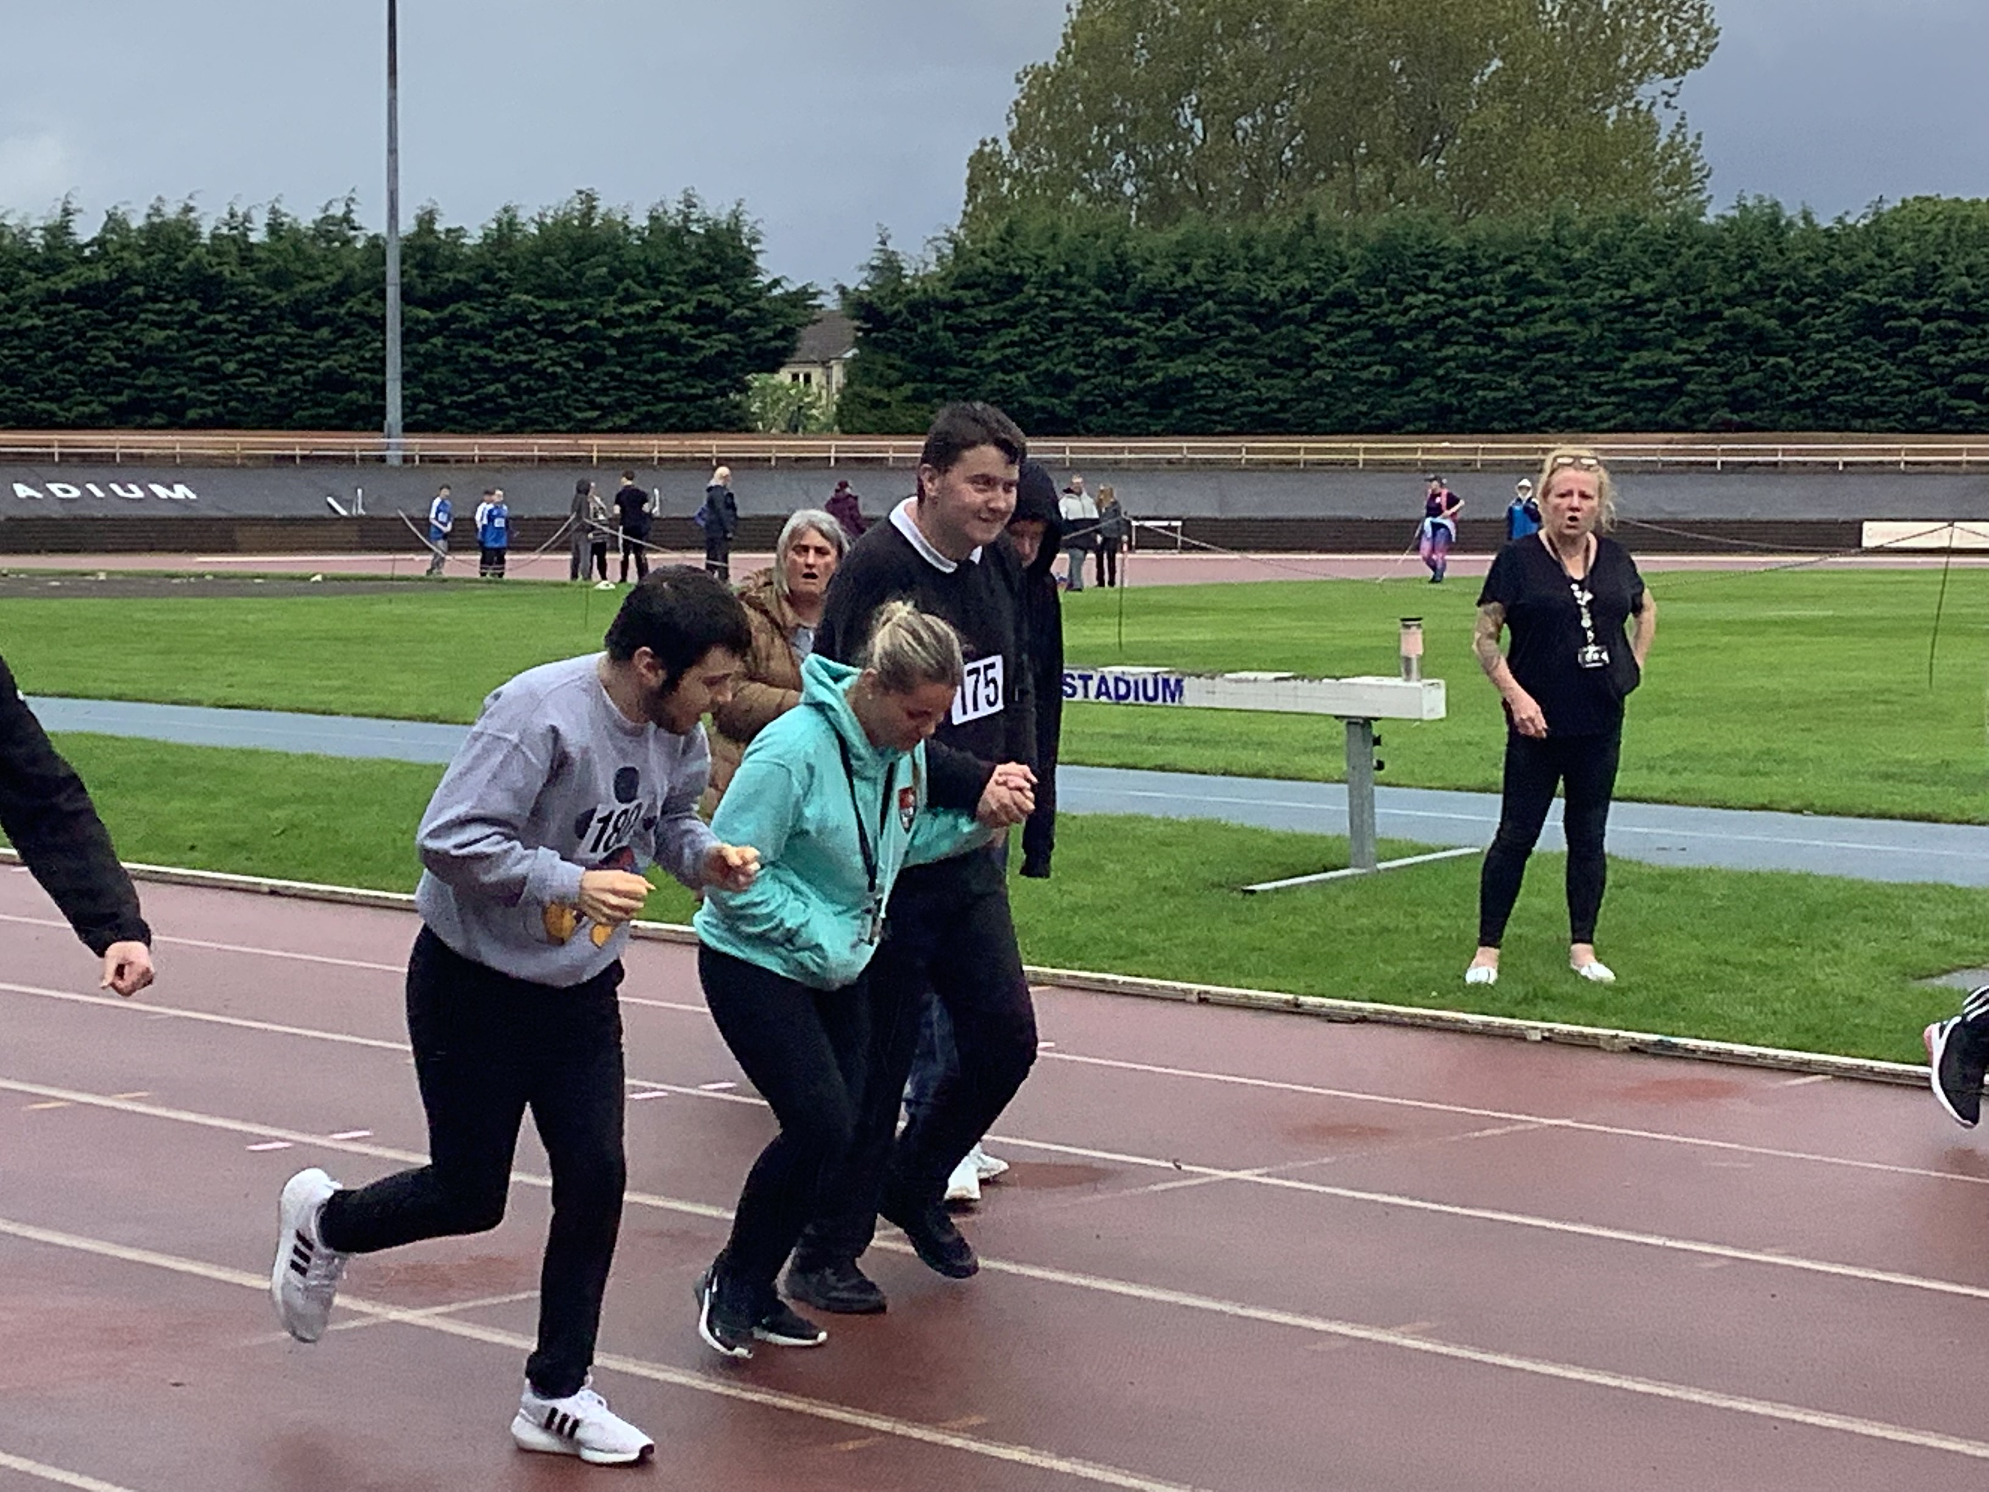
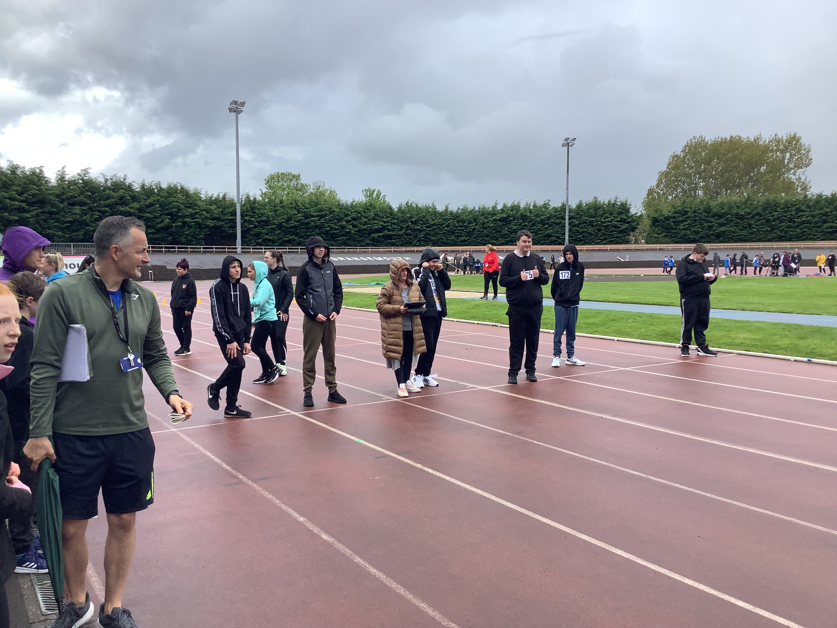
Athletics at Grangemouth Stadium. May 10th
The Athletics at Grangemouth Stadium was a tremendous success for Carrongrange Pupils despite the rainy conditions.
Many medals were won on the day.

Slide 22

Dates for the diary
Date | Event
May 31st/June 1st 2023 | Carrongrange Theatre School Show.
June 14th (Wed) | Carrongrange Senior Prom.
June 15th (Thurs) | Leavers Assembly and Prizegiving.
June 19th 2023 | New Timetable.
June 30th (Fri) | School closes @ 1.30pm for Summer break
August 14th/15th 2023 | In Service Days
August 16th 2023 | Pupils return after Summer break.

Slide 23



Information:
LOST PROPERTY: Please ensure the names of pupils are clearly marked on all items of clothing and equipment.
EMAIL ADDRESS: Please ensure the school is kept up to date with your email address as this is our preferred method of communication.
TELEPHONE NUMBERS: Please ensure the school is kept up to date with any changes to all telephone numbers i.e. home, work and mobile.
PUPIL ABSENCE: Parents and carers are asked to phone into school between 8.30am and 8.45am to inform the school if their child will be absent.

Slide 24
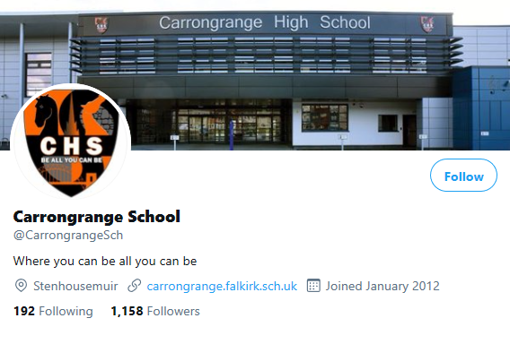



Don’t forgot to follow us on Twitter and Facebook
@CarrongrangeSch
@Ms_Proudlock
Carrongrange High School

Slide 25



www.carrongrange.falkirk.sch.uk
And always remember “Be all you can Be”

